Slide 1
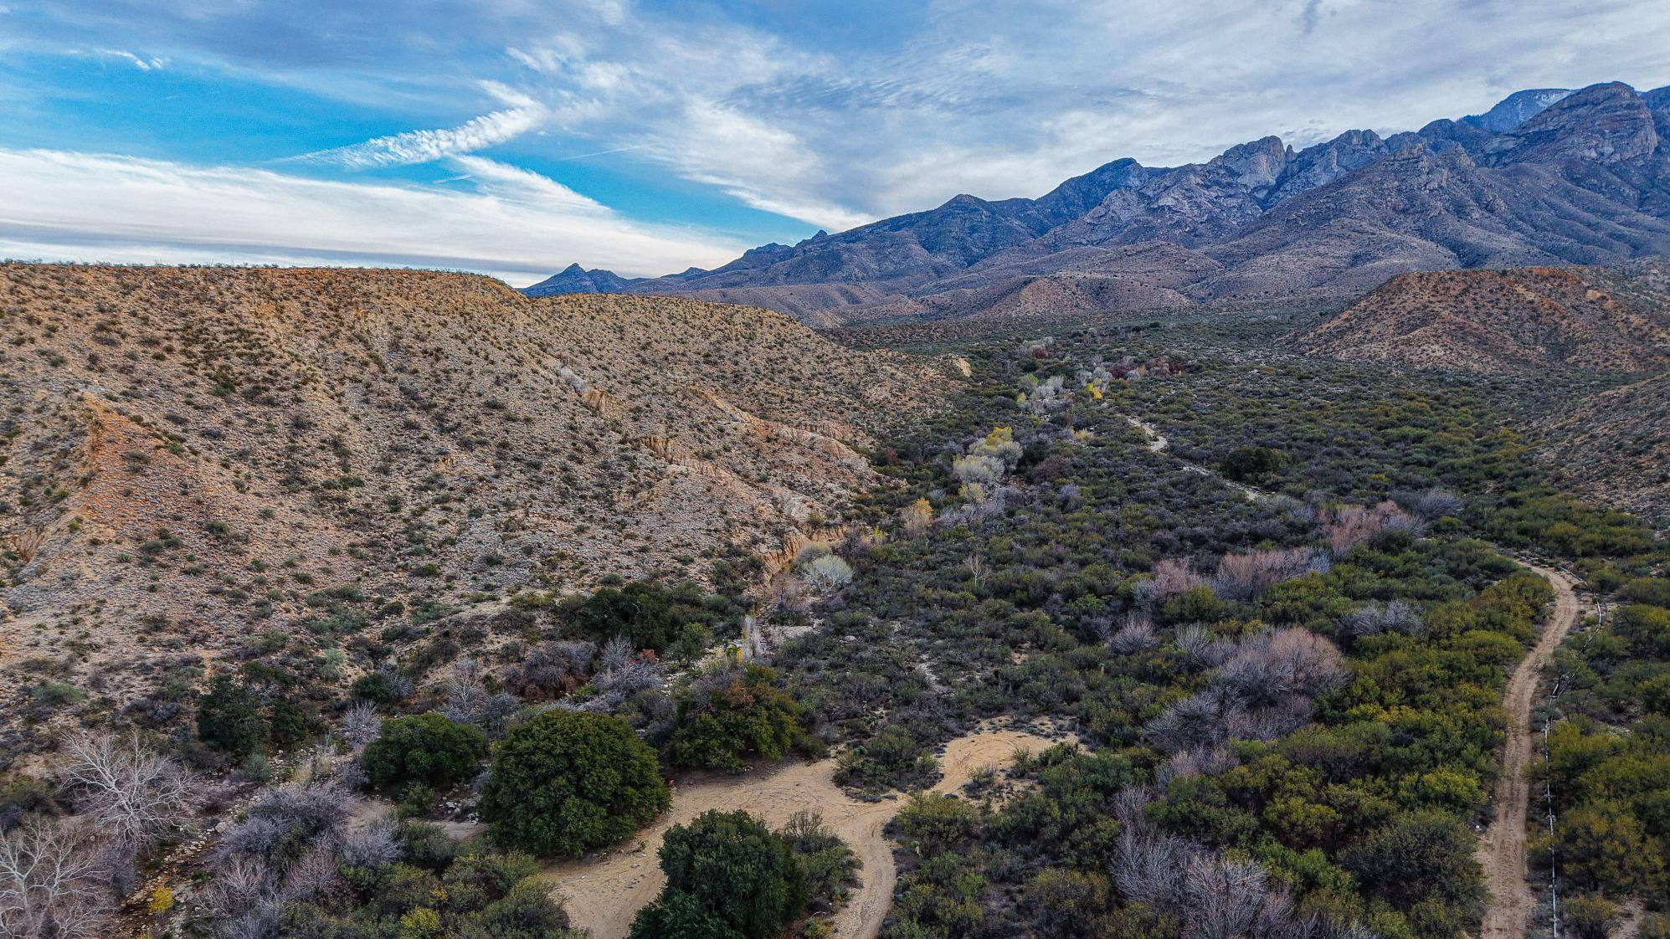
Fan and Fill:
Reconstructing the Past Through Sedimentology and Stratigraphy of Syn- to Post-tectonic Sedimentary Deposits within the Safford Basin, SE AZ
Tye N Ropati and Kelin X Whipple
School of Earth and Space Exploration, Arizona State University
Arizona Space Grant Symposium
April 18, 2026

Slide 2
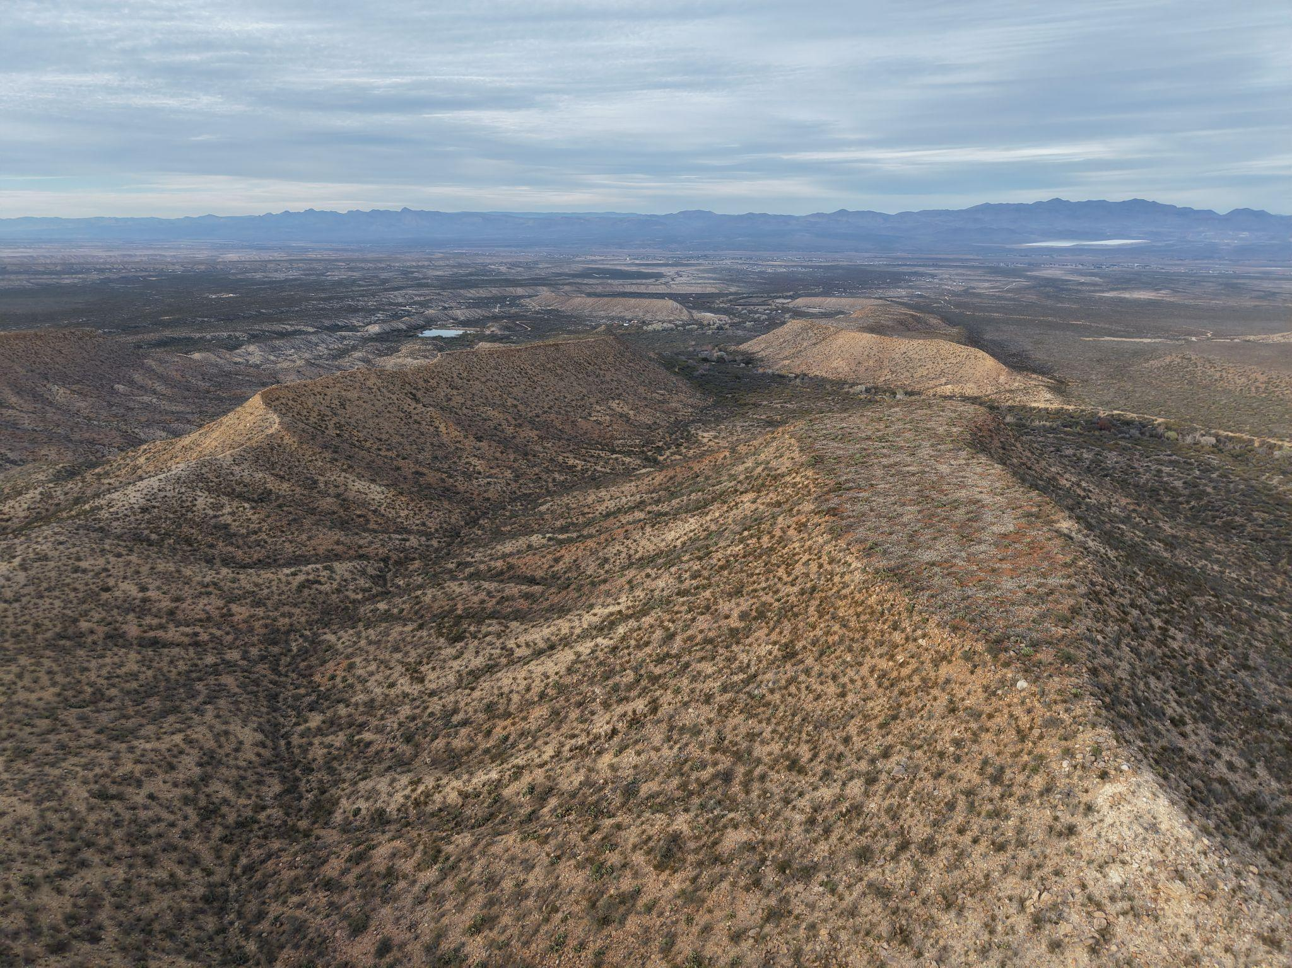
Background

Slide 3
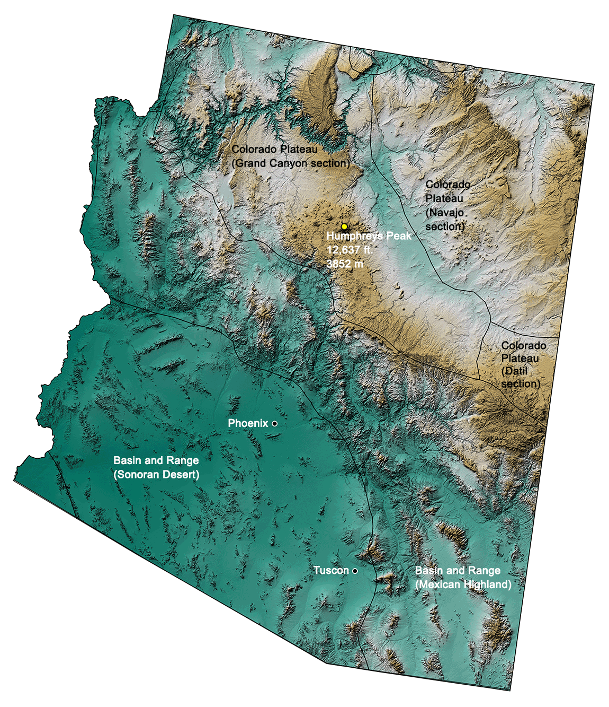
Geologic Setting
Ca. 27 Ma, Arizona’s crust began to extend toward the SE
  First along low-angle detachment faults
12–5 Ma, extension continued through high-angle normal faults
The crust broke into tilting blocks, creating characteristic Basin and Range topography
During and after tectonic extension, sediments were deposited within these basins
Extension

Slide 4
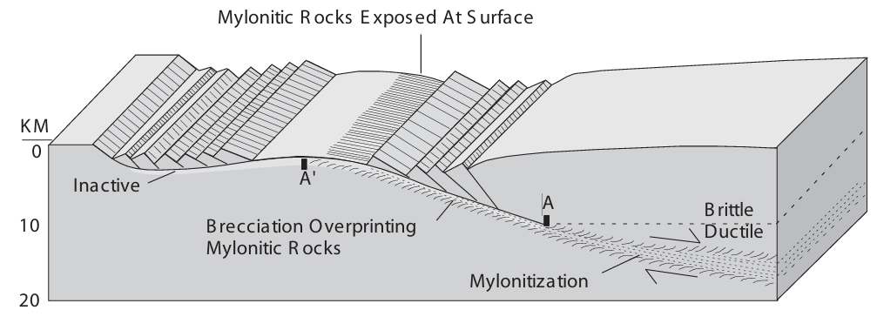
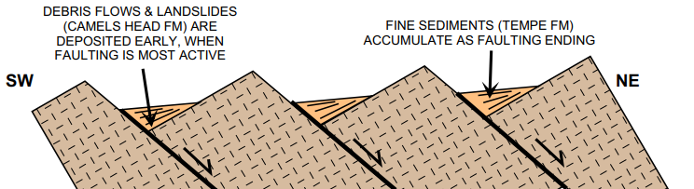
Geologic Setting
Ca. 25 Ma, Arizona’s crust began to extend toward the SE
  First along low-angle detachment faults
12–5 Ma, extension continued through high-angle normal faults, creating characteristic Basin and Range topography
During and after tectonic extension, sediments were deposited within these basins
After 2 Ma, the basin filled enough to integrate into the Gila River system
Reynolds and Bartlett, 2002

Slide 5
What can we learn from sedimentary rocks and deposits?
Sedimentary deposition is modulated by specific conditions and processes, like tectonics and climate
As a product of these conditions, they tell us what has happening in the past
In complement to other methods, sedimentology and stratigraphy are powerful tools
Sedimentary deposits are a detailed record of local and regional history!

Slide 6
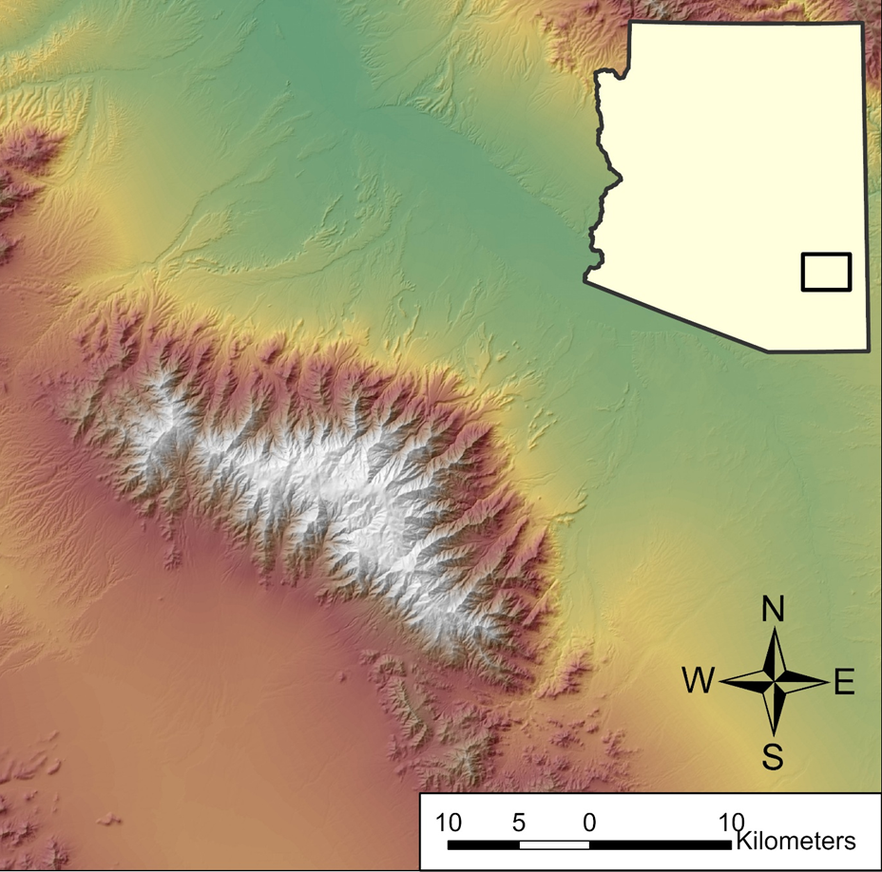
Legacy of work in

Slide 7
Problem
Legacy of work in the Pinaleño Mts
  Landscape evolution and channel erosion
Pattern of gravel-capped mesas with underlying fine-grained sediments
A big change in grain size suggests a drastic change → climatic shift?
Why would there be a layer of gravels capping everything in the basin?
Why do the “levels” of the caps vary?

Slide 9
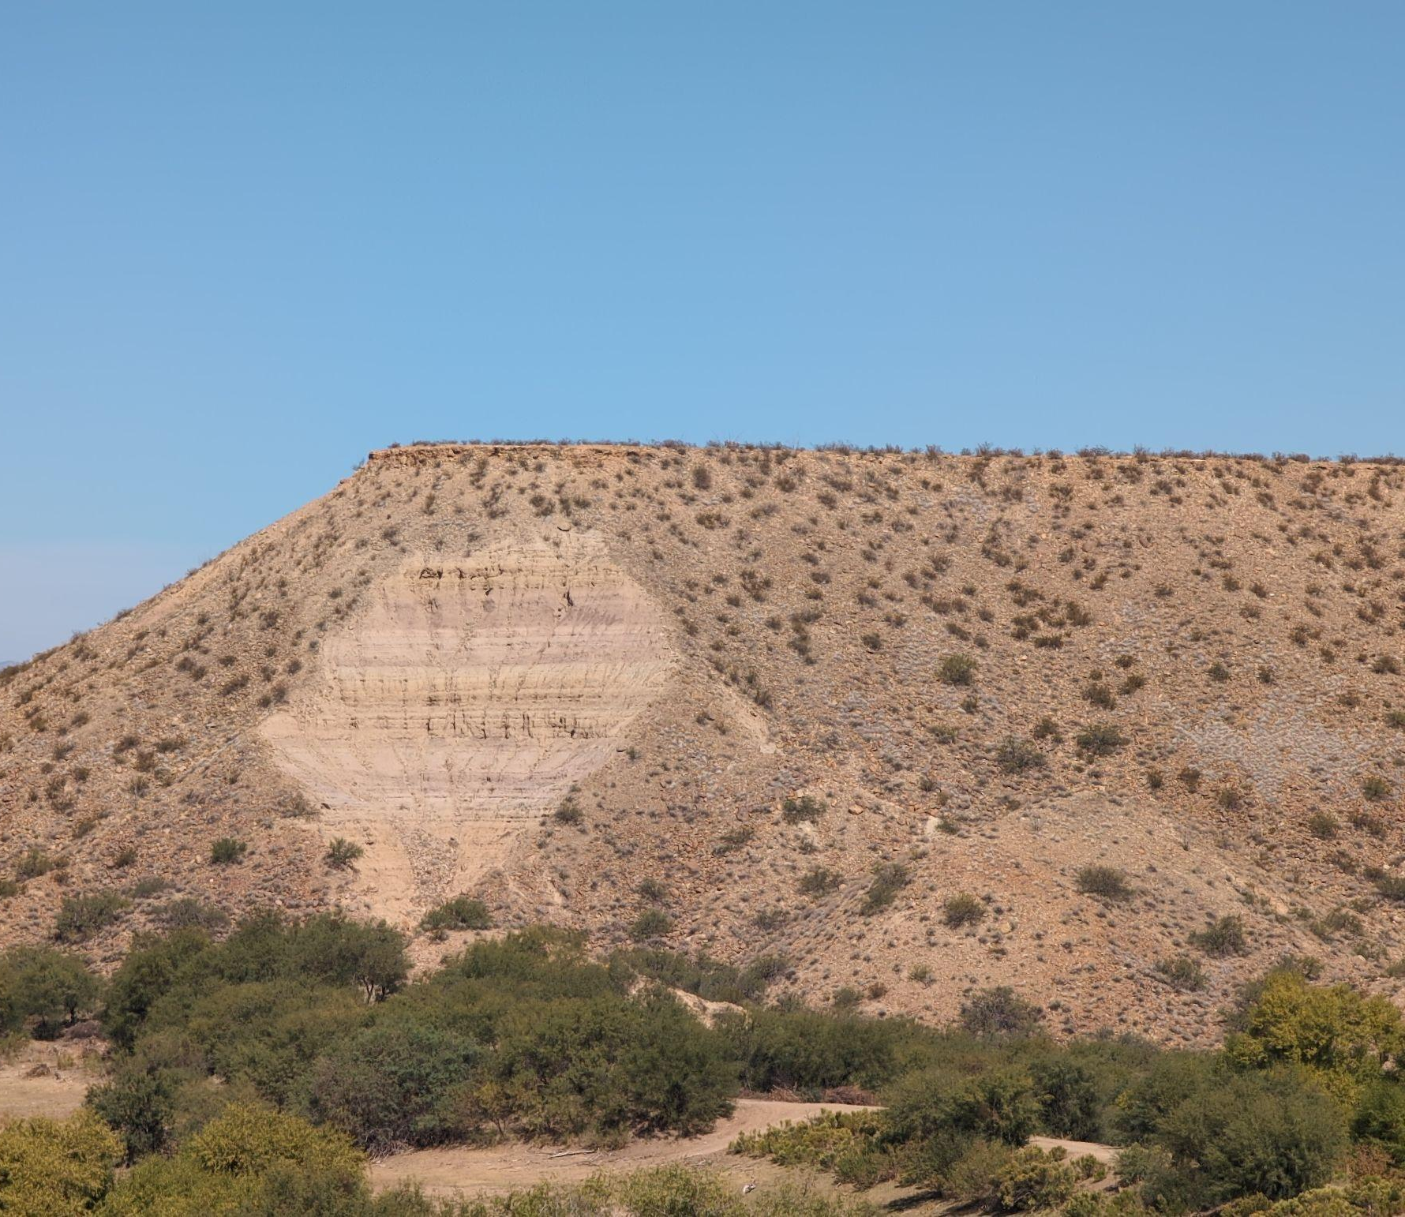
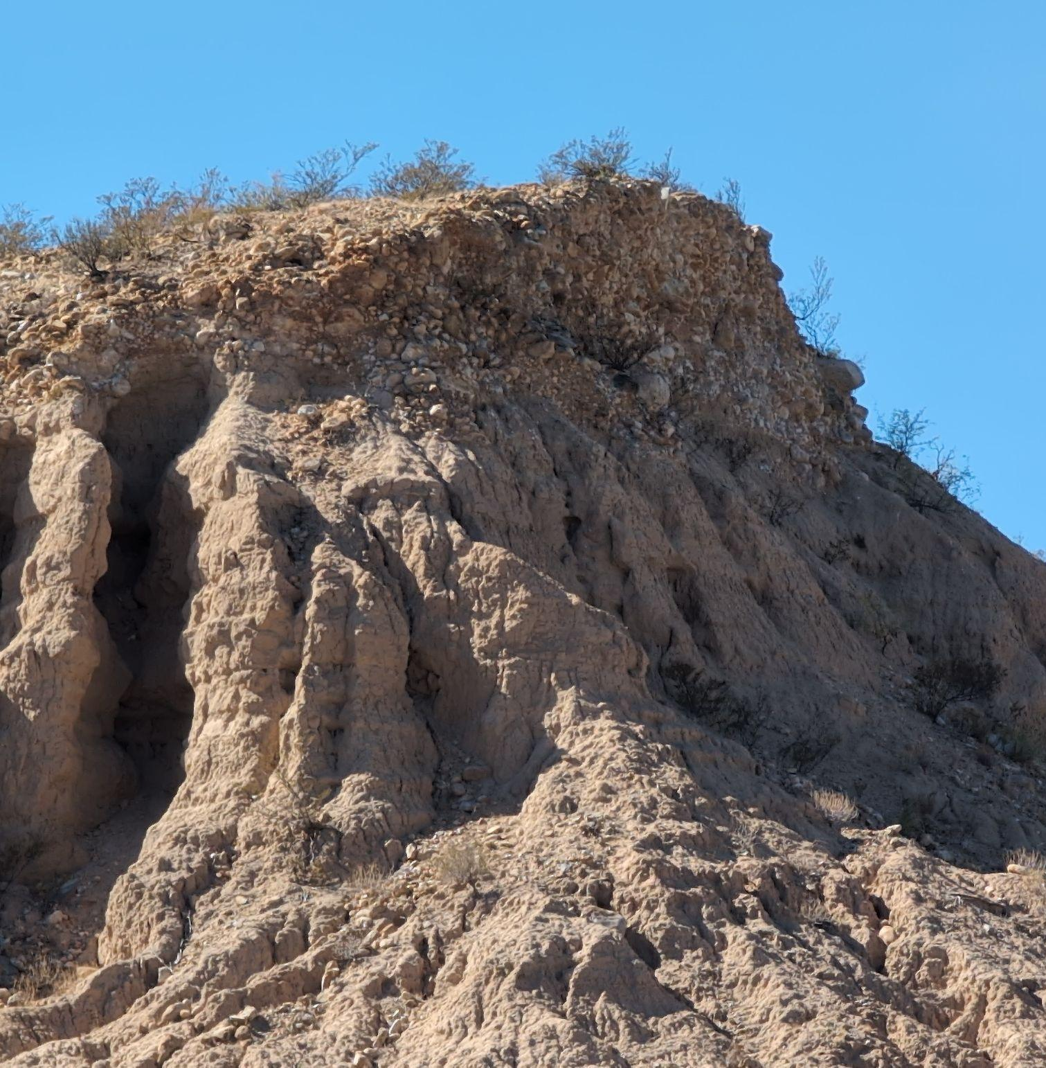
Problem
Legacy of work in the Pinaleño Mts
  Landscape evolution and channel erosion
Pattern of gravel-capped mesas with underlying fine-grained sediments
A big change in grain size suggests a drastic change → climatic shift?
Why would there be a layer of gravels capping everything in the basin?
Why do the “levels” of the caps vary?

Slide 10
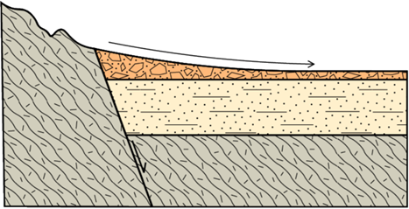
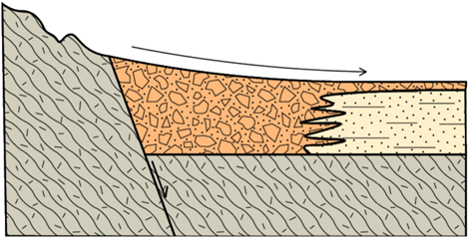
Objectives
Same or Different?
Explore the relationship between the gravel cap and the underlying basin fill.
Two hypotheses:
Climatic shift: a change in climate changed the grain size of sediment being transported.
Facies migration: both facies were depositing at the same time, but the fan prograded over the fine-grains
How do we test this?
  Look for evidence of alluvial fan gravels lower in section or laterally adjacent to fine-grained basin fill deposits

Slide 11
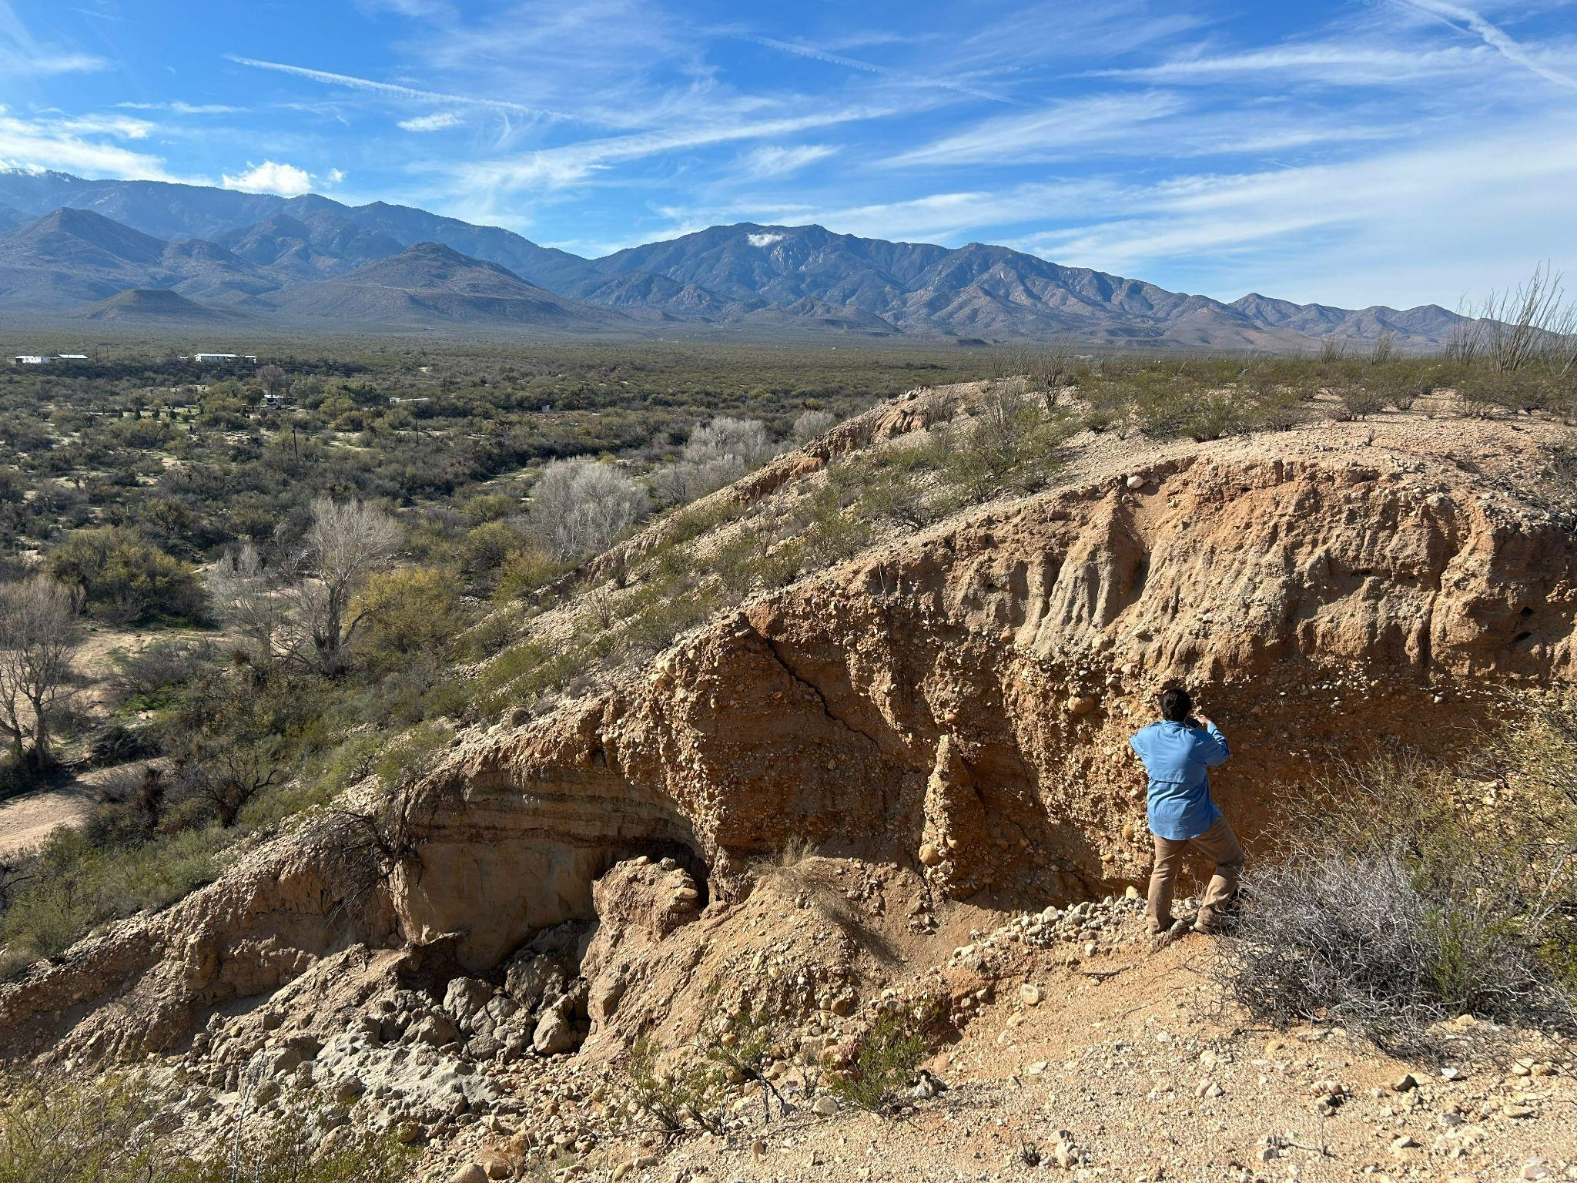
Methods

Slide 12
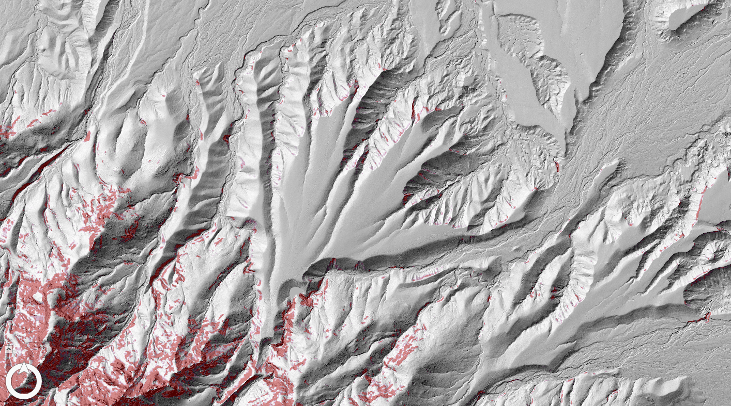
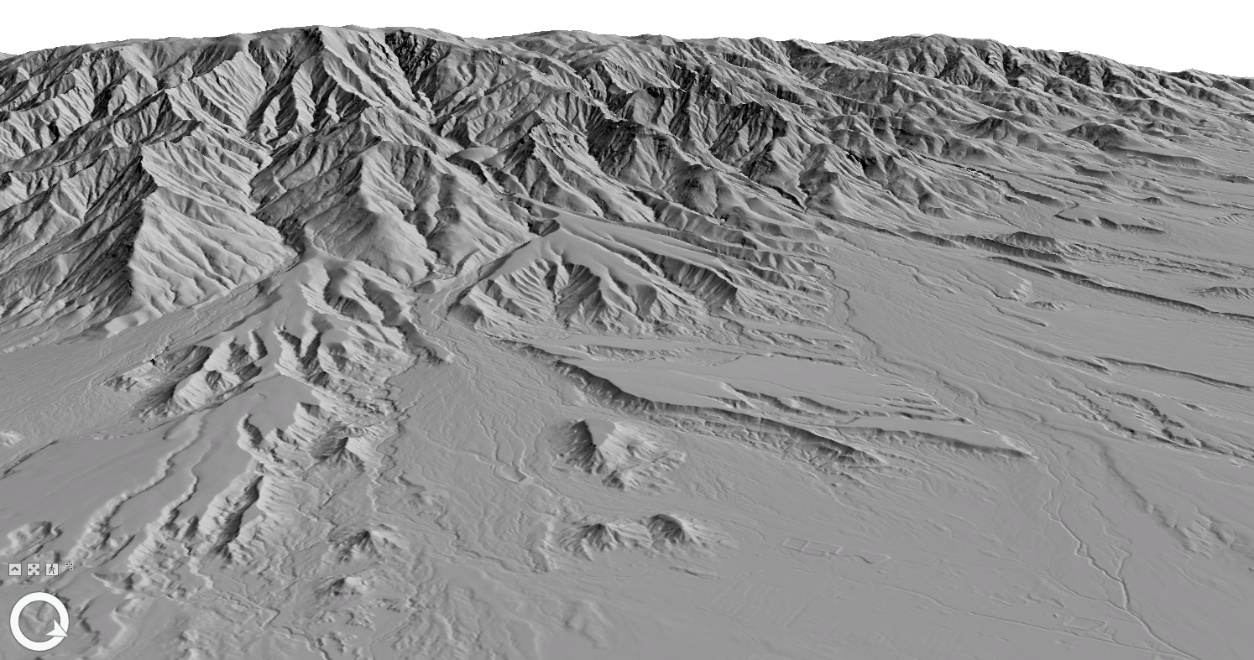
Recon and Planning
Consultation of previous geologic maps
GIS analysis of topographic data
  LiDAR DEM: 1, 5, and 10 m resolution
  DEM → hillshade, slopemap, 3D surface in ArcGIS Pro
Locate potential exposures
Identify topographic/geomorphic patterns
Creation of an efficient itinerary/plan

Slide 13
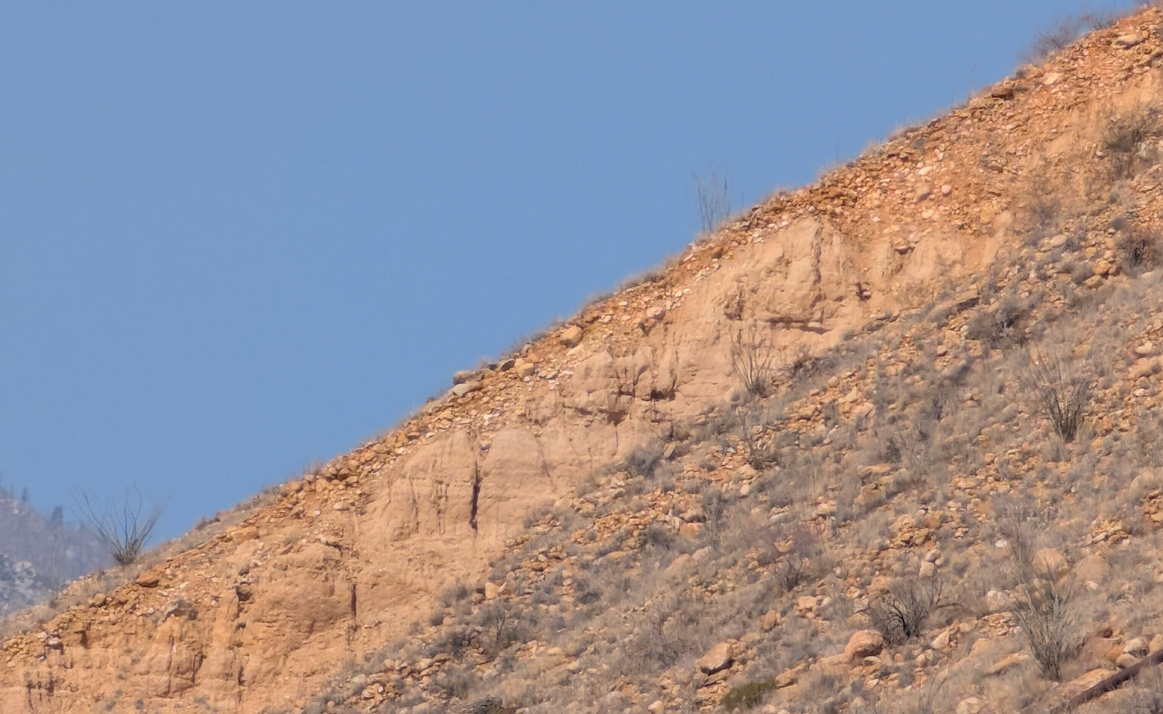
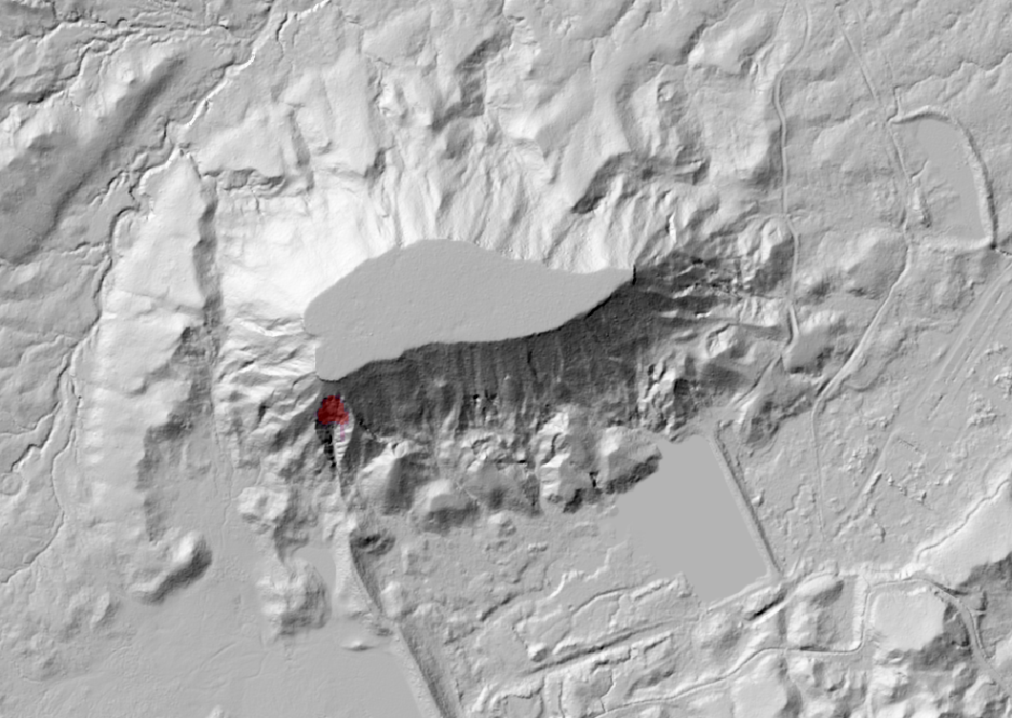
Recon and Planning
Consultation of previous geologic maps
GIS analysis of topographic data
  LiDAR DEM: 1, 5, and 10 m resolution
  DEM → hillshade, slopemap, 3D surface in ArcGIS Pro
Locate potential exposures
  Crucial for data collection
  Slopemap with 35º threshold
Identify topographic/geomorphic patterns
Creation of an efficient itinerary/plan

Slide 14
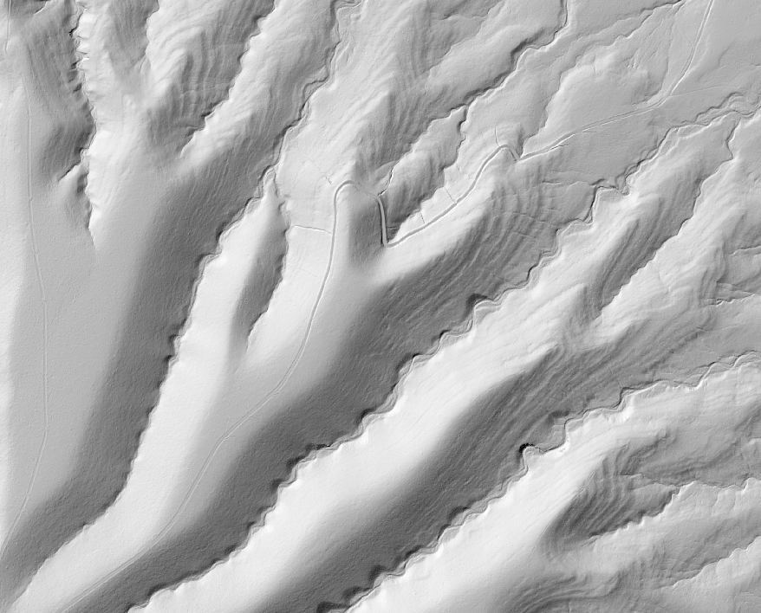
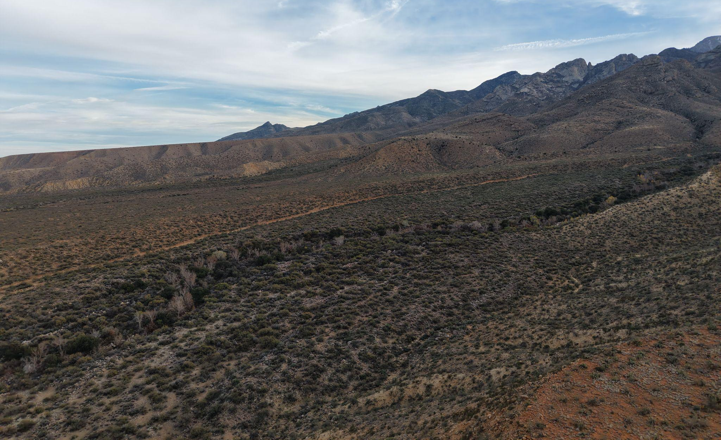
Recon and Planning
Consultation of previous geologic maps
GIS analysis of topographic data
  LiDAR DEM: 1, 5, and 10 m resolution
  DEM → hillshade, slopemap, 3D surface in ArcGIS Pro
Locate potential exposures
Identify topographic/geomorphic patterns
  What can patterns in the topography tell us?
  Differentiating between different surfaces
Creation of an efficient itinerary/plan

Slide 15
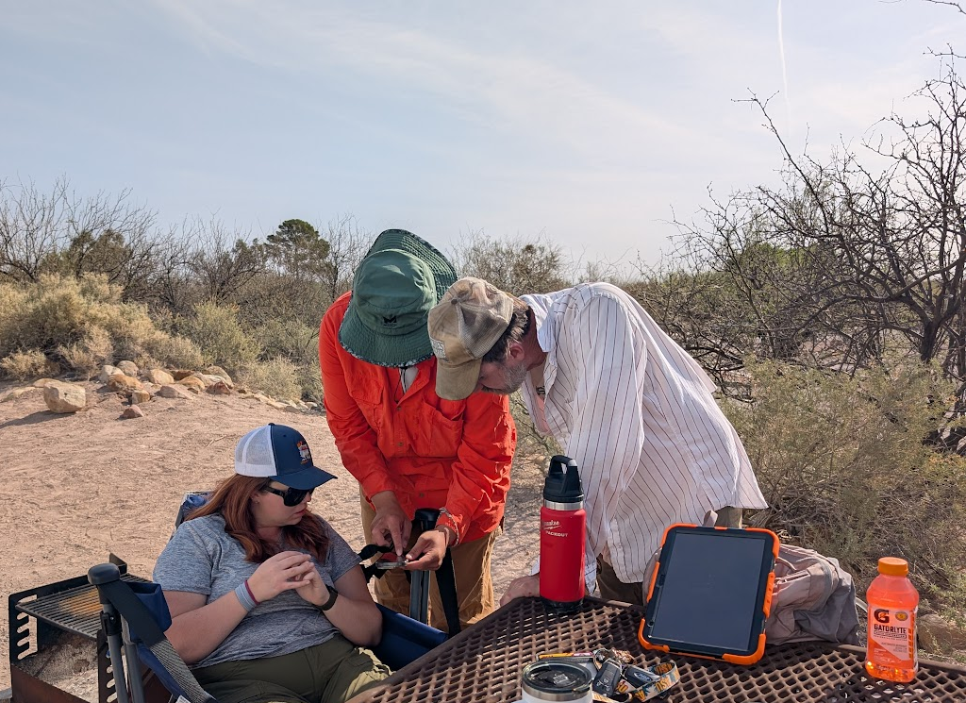
Recon and Planning
Consultation of previous geologic maps
GIS analysis of topographic data
  LiDAR DEM: 1, 5, and 10 m resolution
  DEM → hillshade, slopemap, 3D surface in ArcGIS Pro
Locate potential exposures
Identify topographic/geomorphic patterns
Creation of an efficient itinerary/plan
  Ranking site priority, exposure potental, ease of access, etc.
  Road proximity/quality and property ownership were major issues

Slide 16
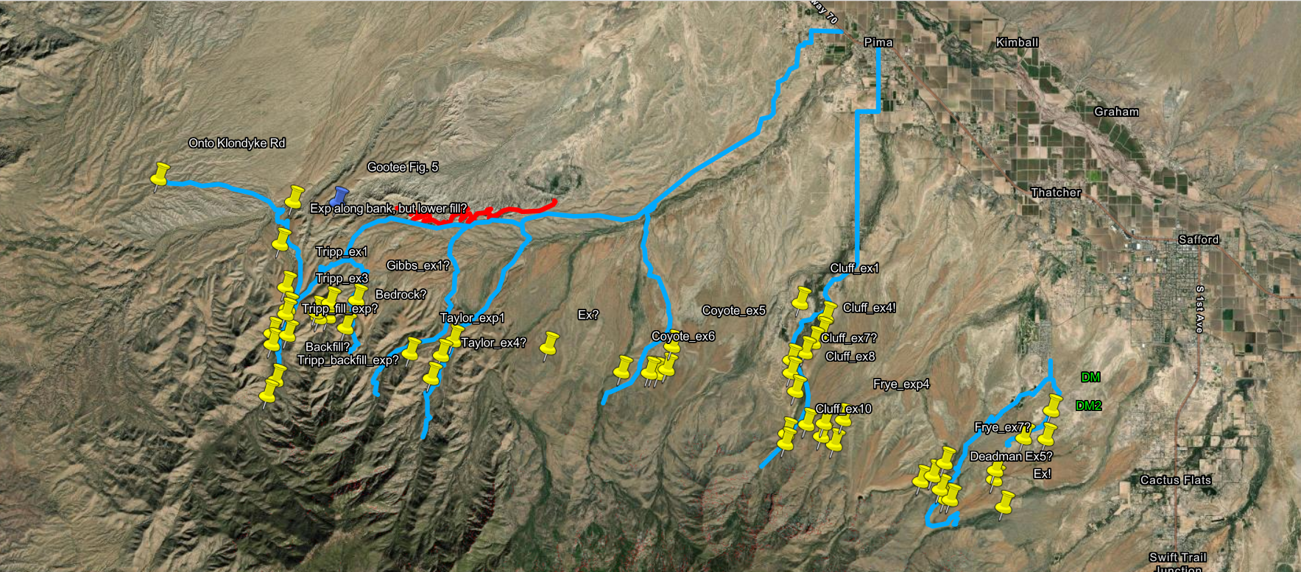
Recon and Planning

Slide 17
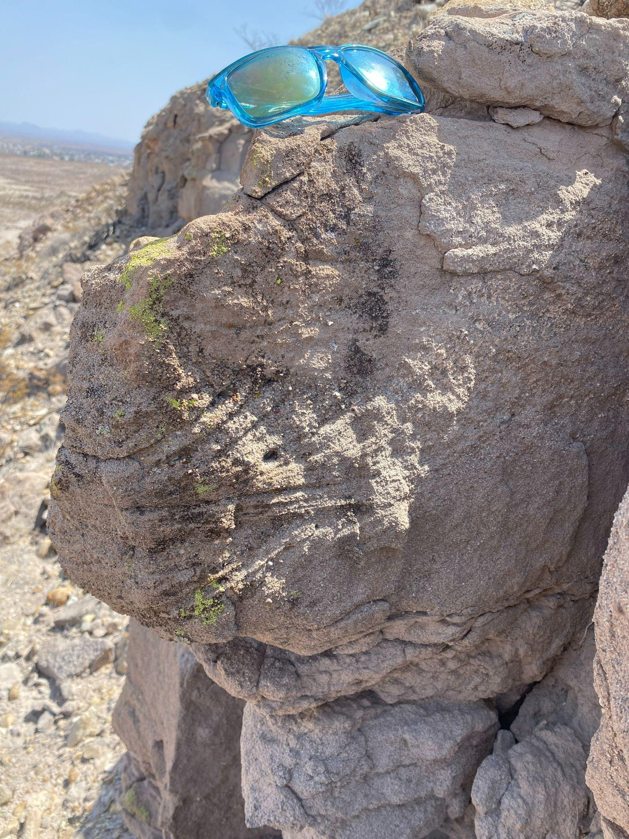
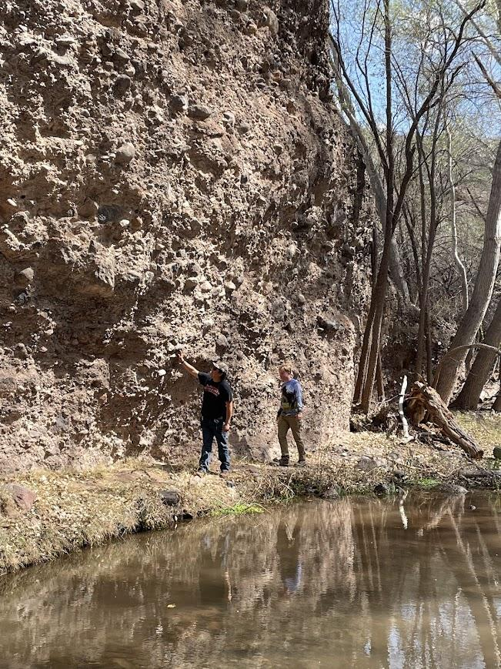
Fieldwork
Find exposures and record their sedimentological characteristics
  Grain size, sedimentary structures, facies interpretation
Observations on foot, by truck, through binoculars, and from drone
Build a patchwork of outcrops to understand the architecture of facies
Draw the contacts between sedimentary units, infer geometry, and draw a geologic map
Flow

Slide 18
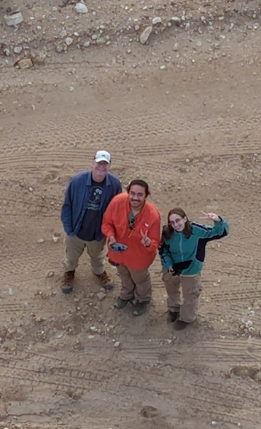
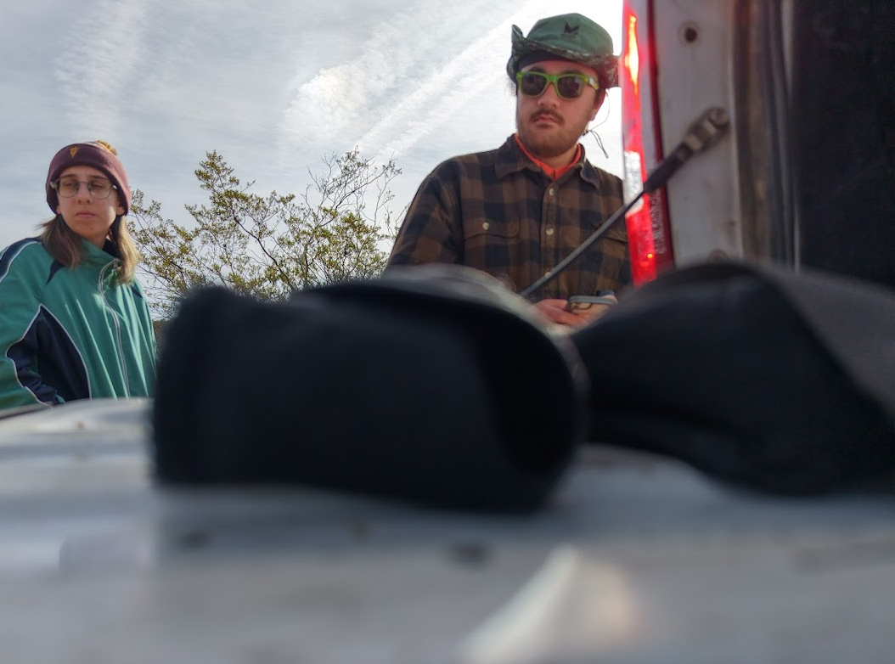
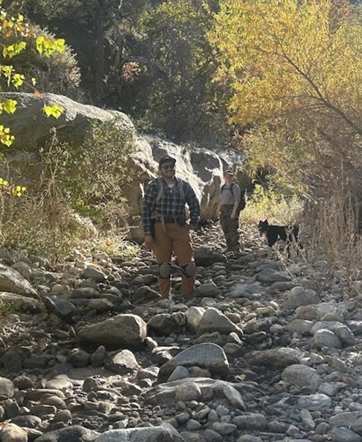
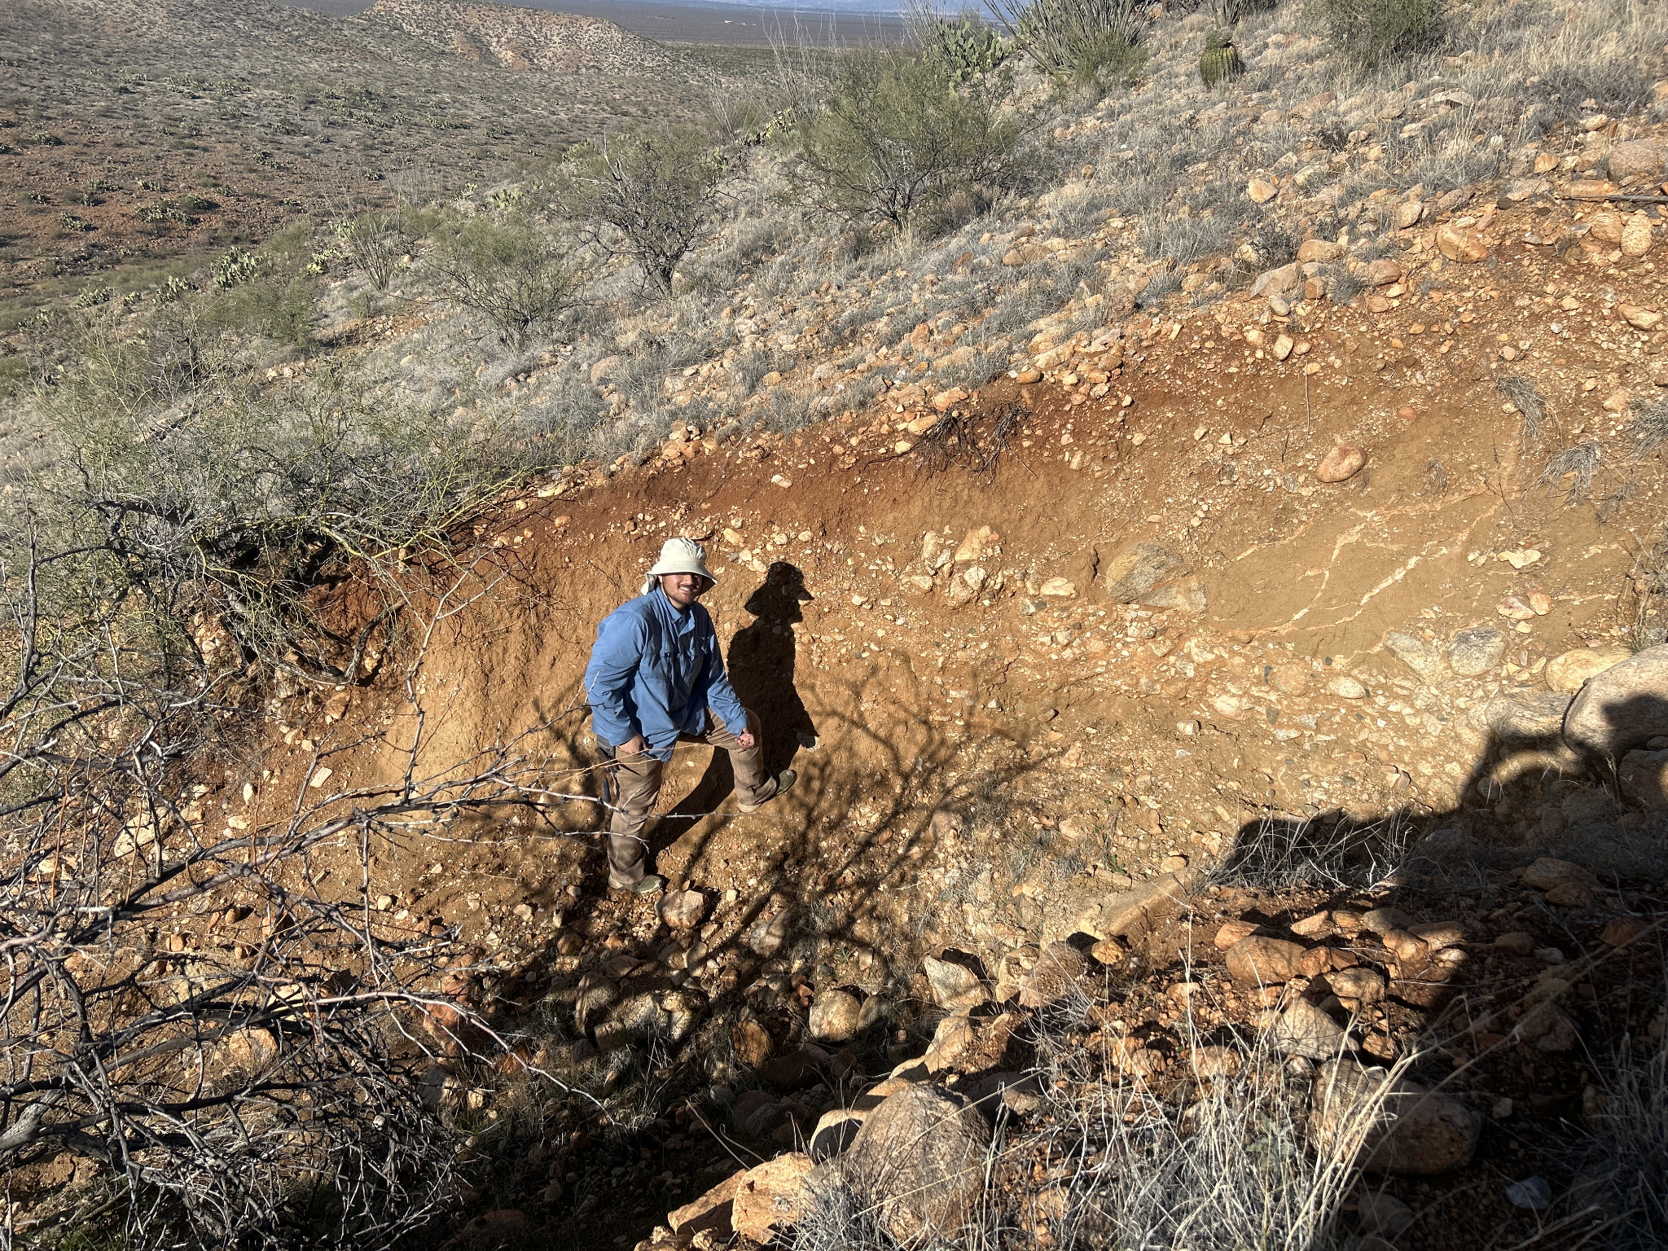
Fieldwork
Find exposures and record their sedimentological characteristics
  Grain size, sedimentary structures, facies interpretation
Observations on foot, by truck, through binoculars, and from drone
Build a patchwork of outcrops to understand the architecture of facies
Draw the contacts between sedimentary units, infer geometry, and draw a geologic map

Slide 19
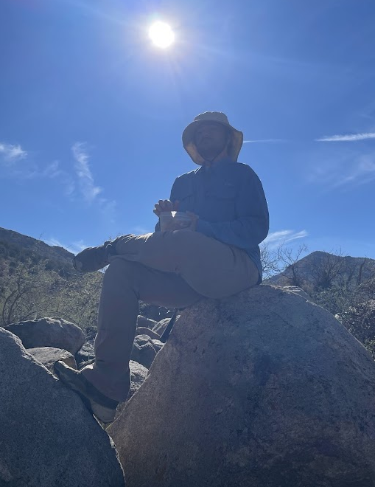
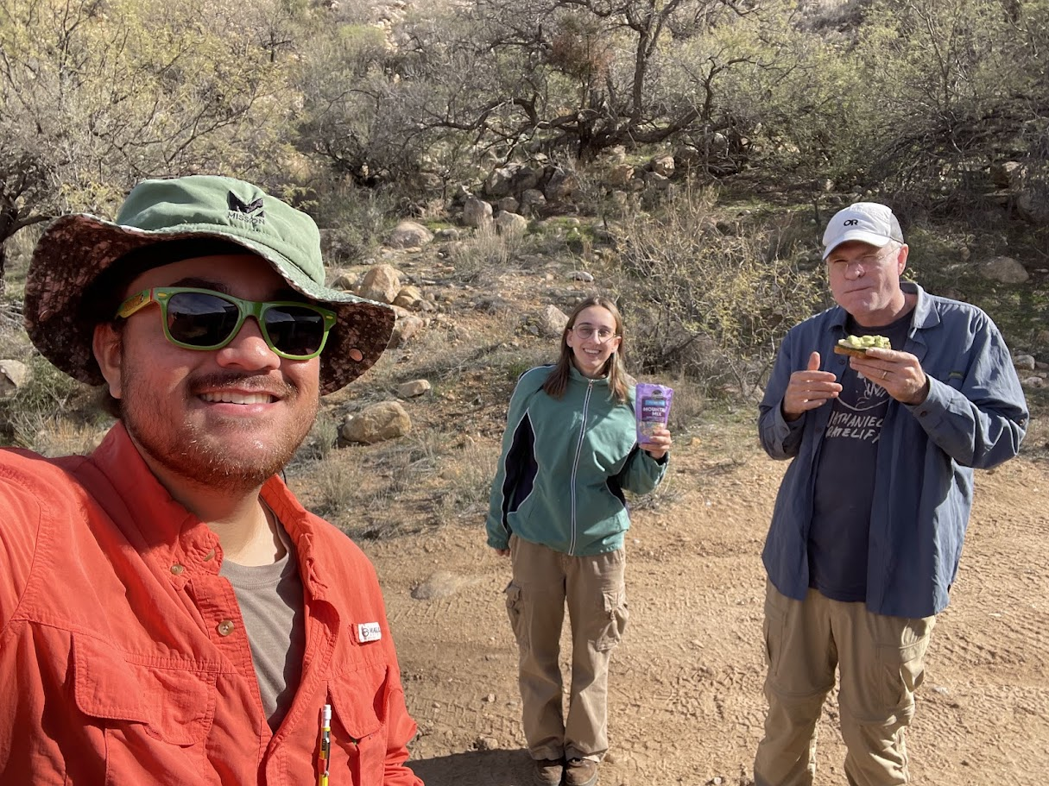
Fieldwork
Find exposures and record their sedimentological characteristics
  Grain size, sedimentary structures, facies interpretation
Observations on foot, by truck, through binoculars, and from drone
Build a patchwork of outcrops to understand the architecture of facies
Draw the contacts between sedimentary units, infer geometry, and draw a geologic map

Slide 20
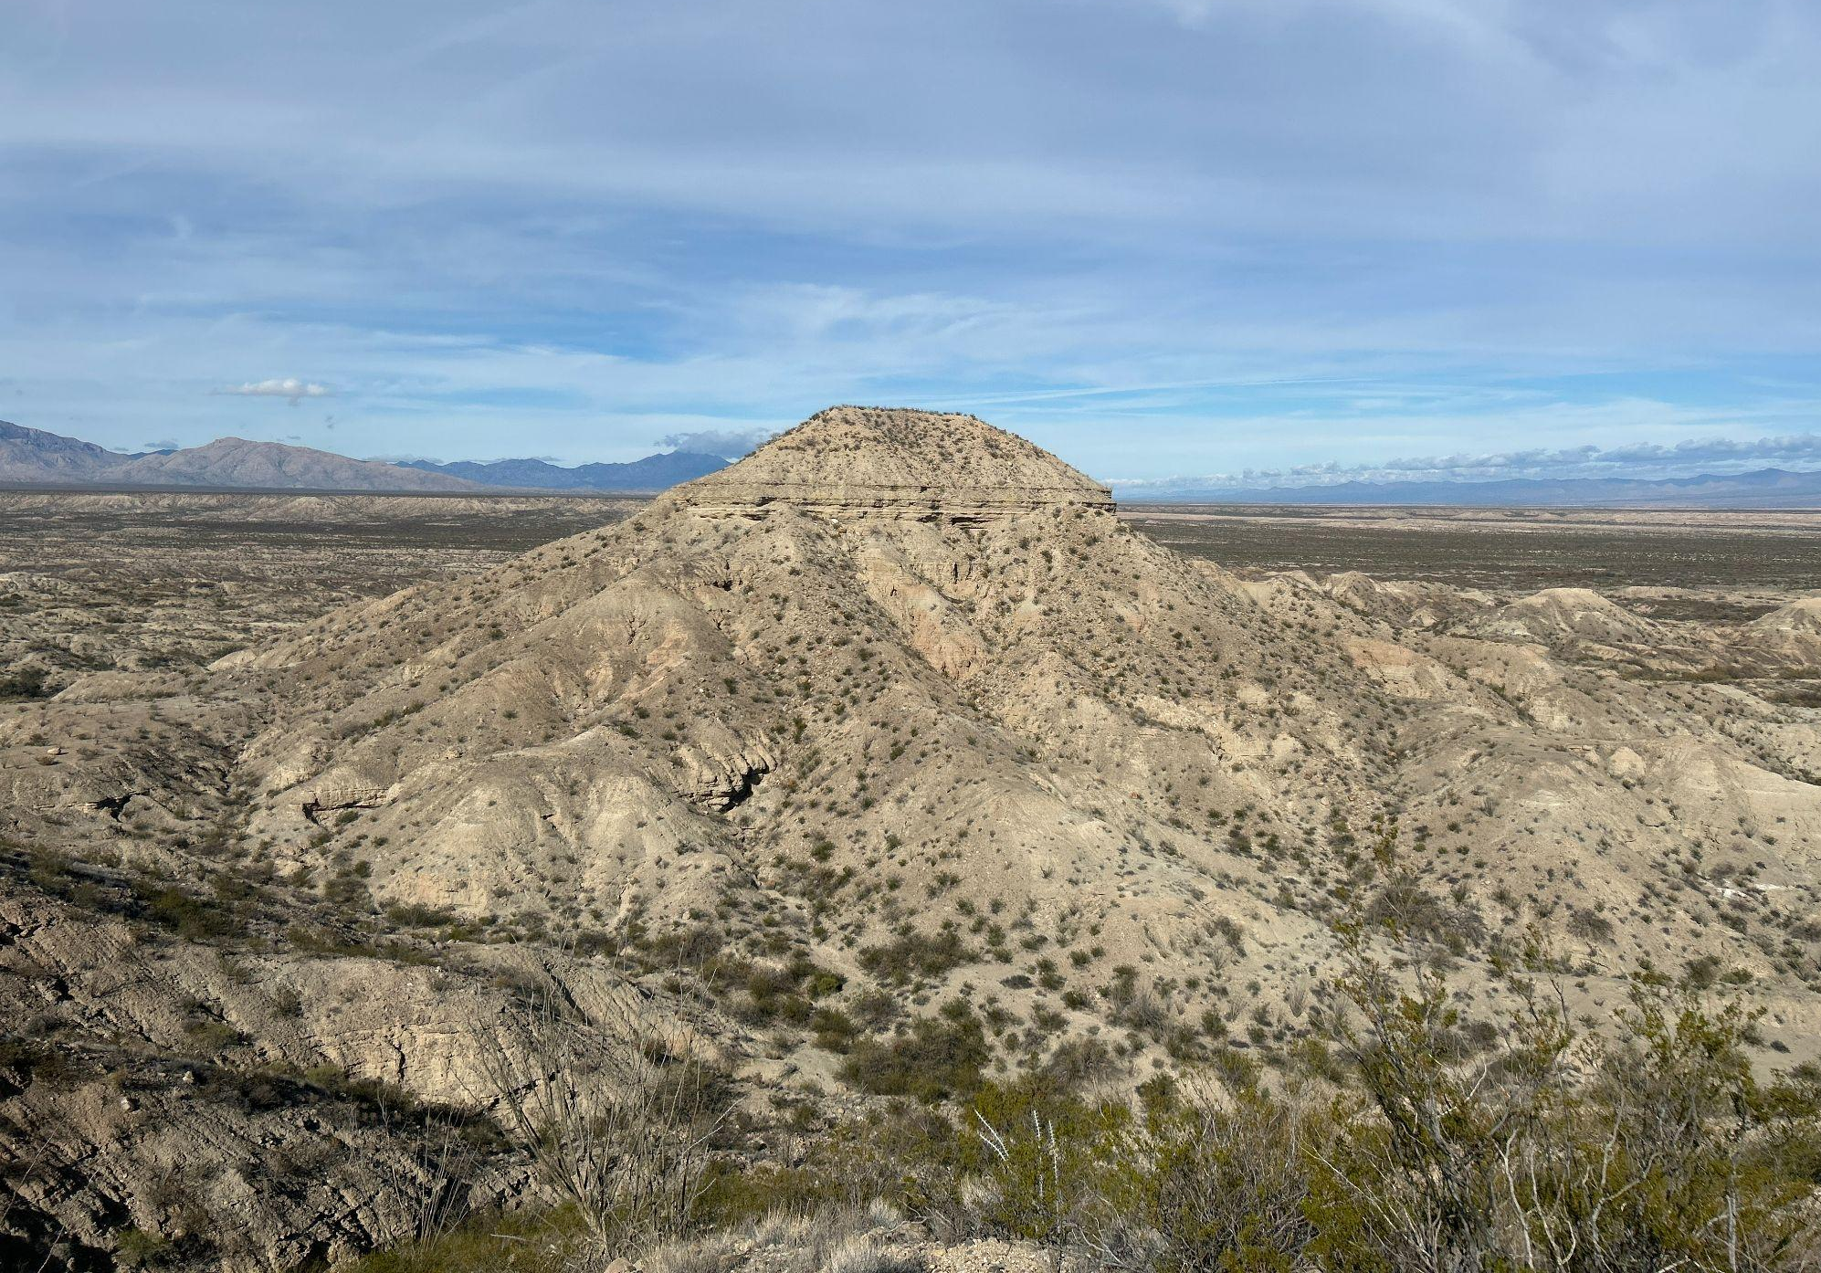
Results

Slide 21
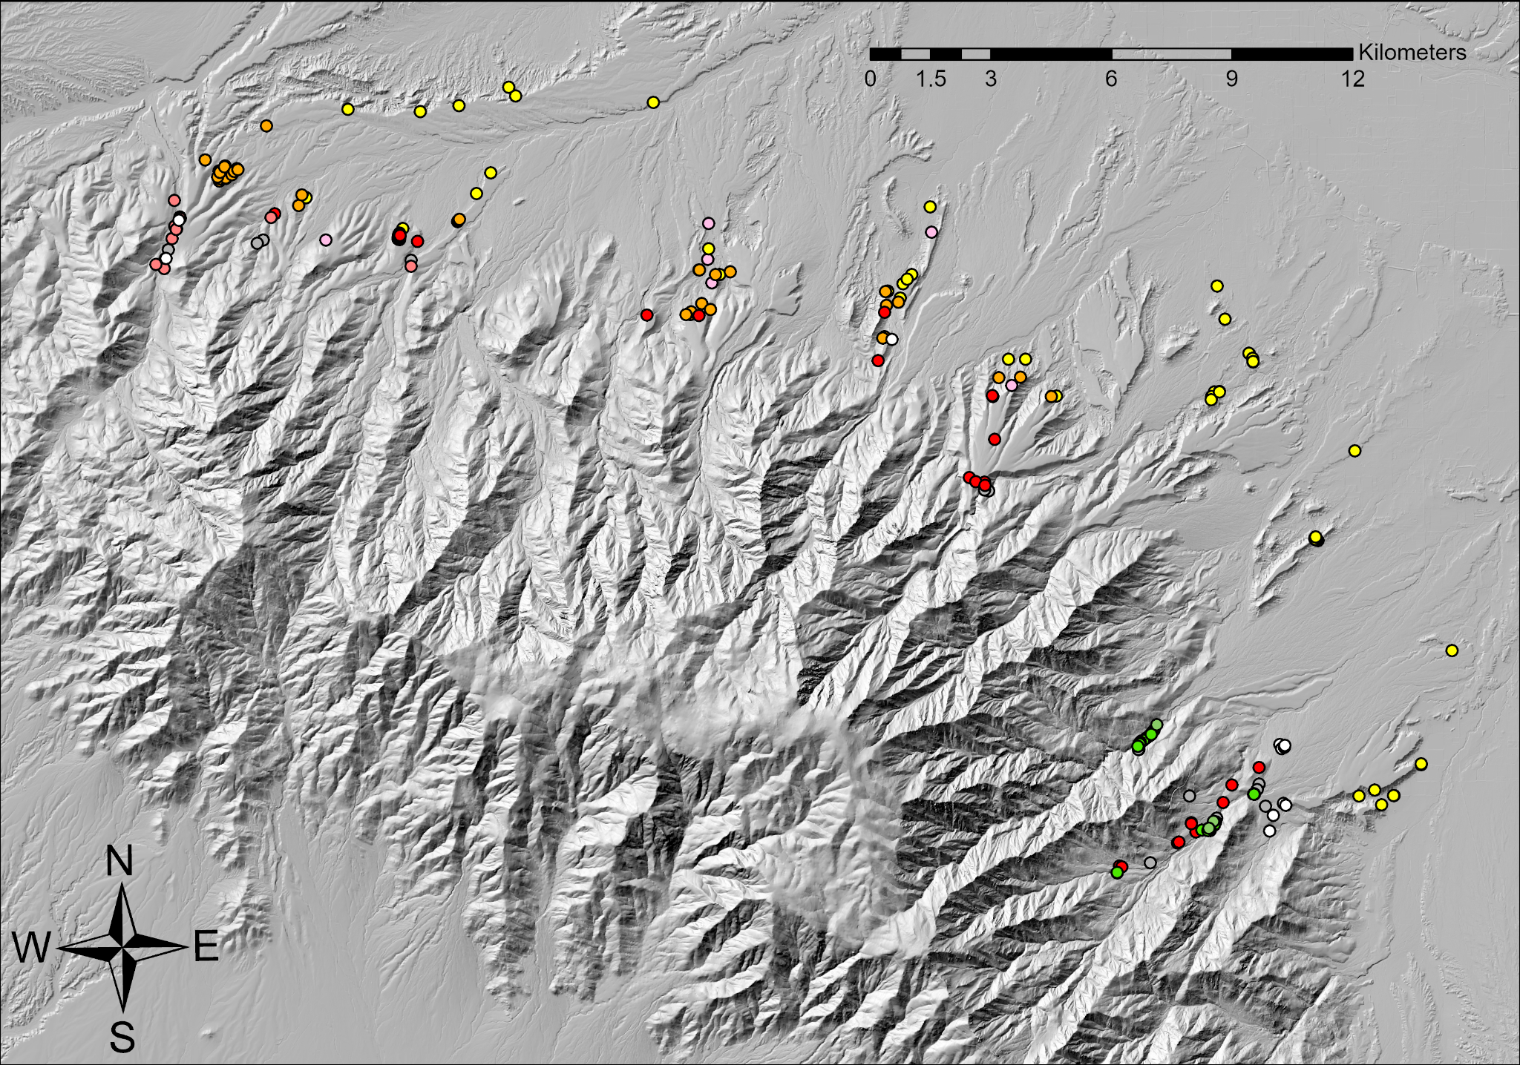

Slide 22
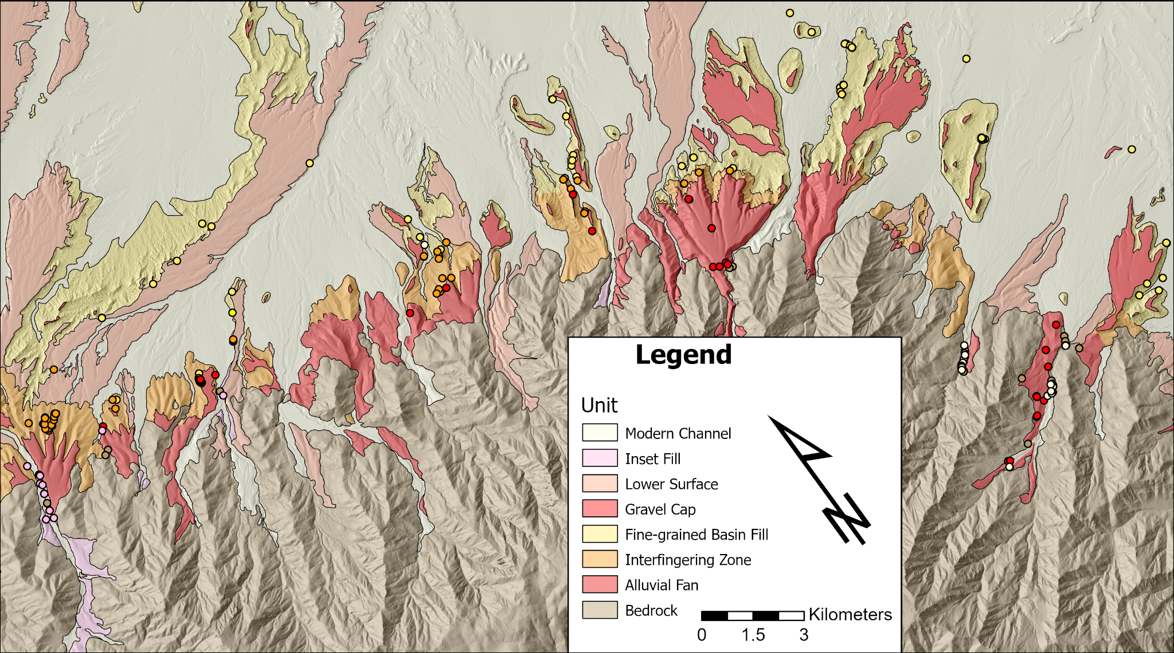

Slide 23
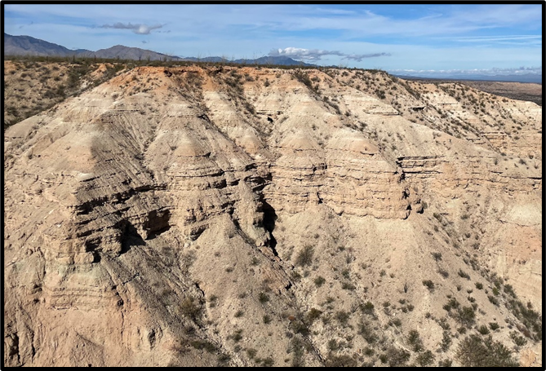
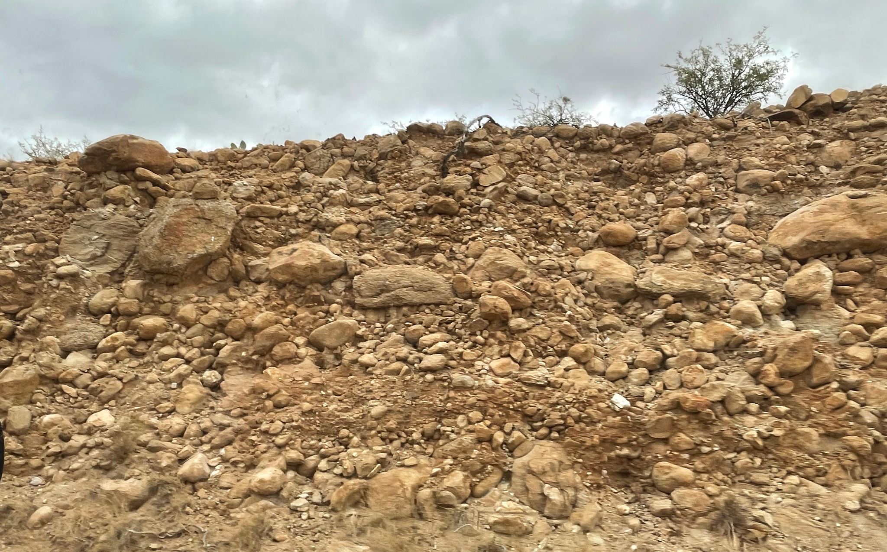
Map Units
Three major basin fill units:
  Fine-grained basin fill
    Lacustrine and fluvio-deltaic facies
  Coarse-grained alluvium
    Proximal to medial alluvial fan gravels
  Transition zone of “interfingering fine and coarse facies”
In addition to other map units
  Lower gravel cap surfaces, modern alluvial channels, inset fill, undifferentiated bedrock

Slide 24
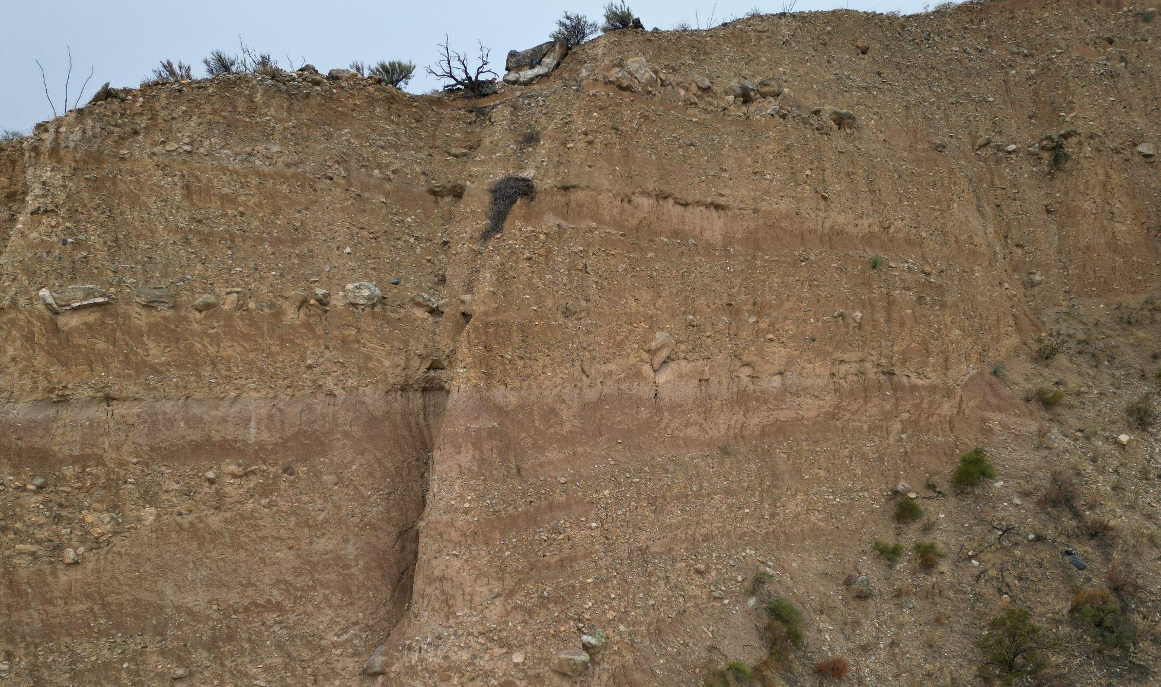
Map Units
Three major basin fill units:
  Fine-grained basin fill
    Lacustrine and fluvio-deltaic facies
  Coarse-grained alluvium
    Proximal to medial alluvial fan gravels
  Transition zone of “interfingering fine and coarse facies”
In addition to other map units
  Lower gravel cap surfaces, modern alluvial channels, inset fill, undifferentiated bedrock

Slide 25
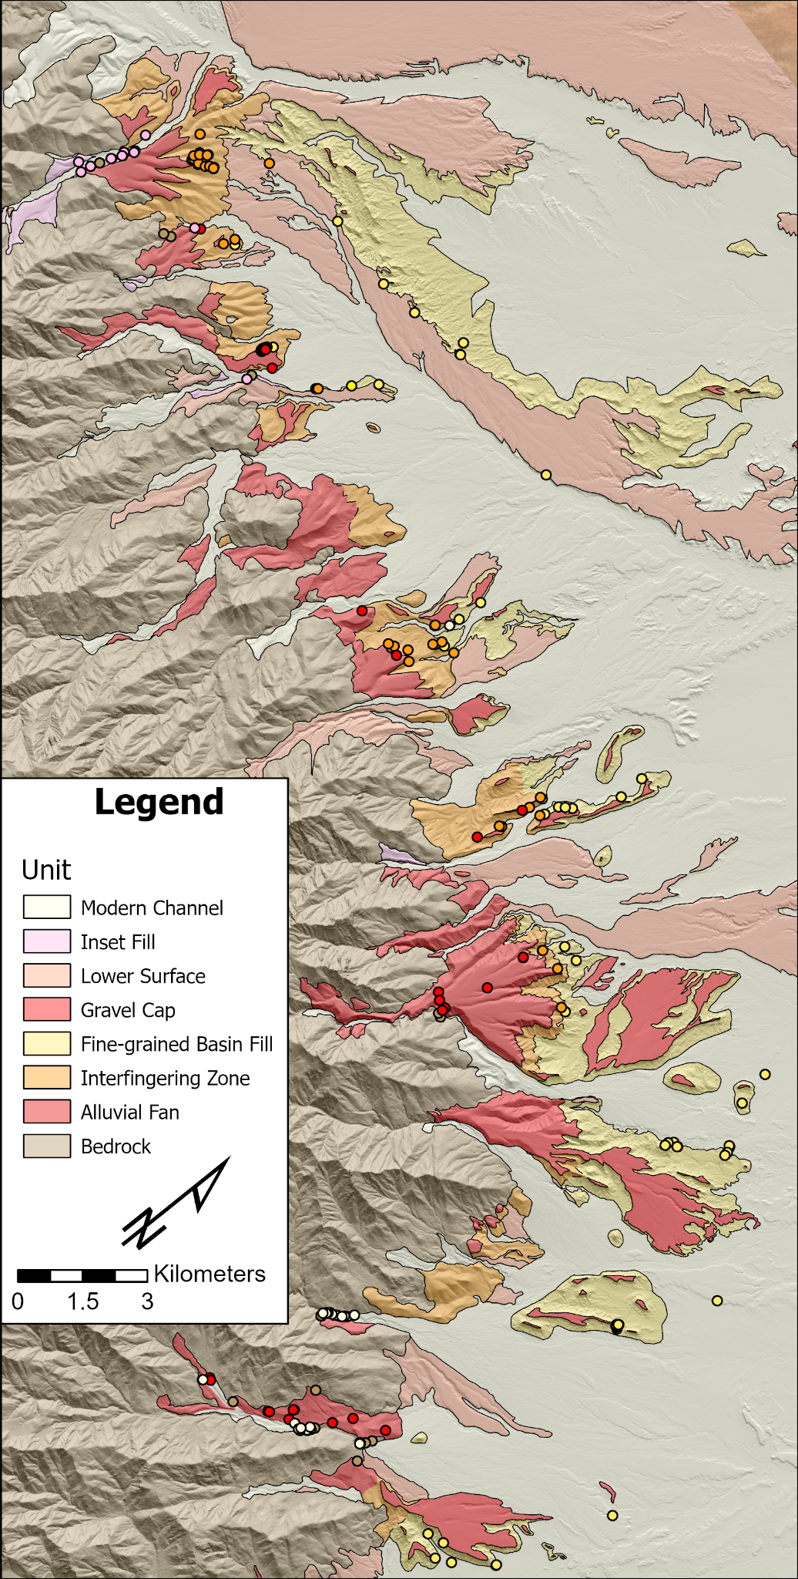
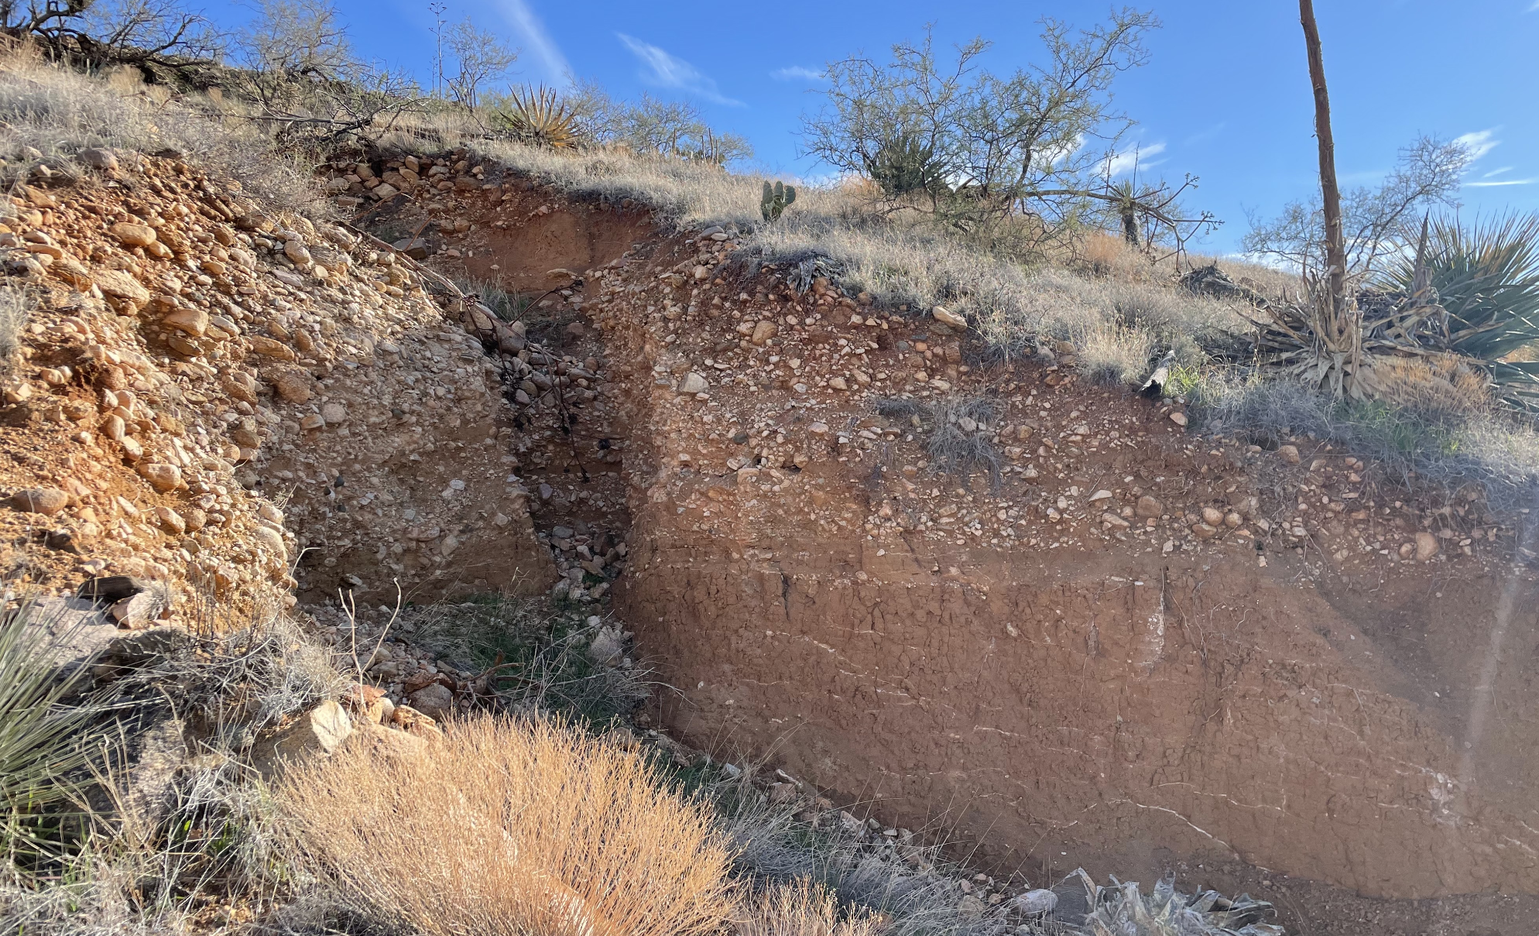
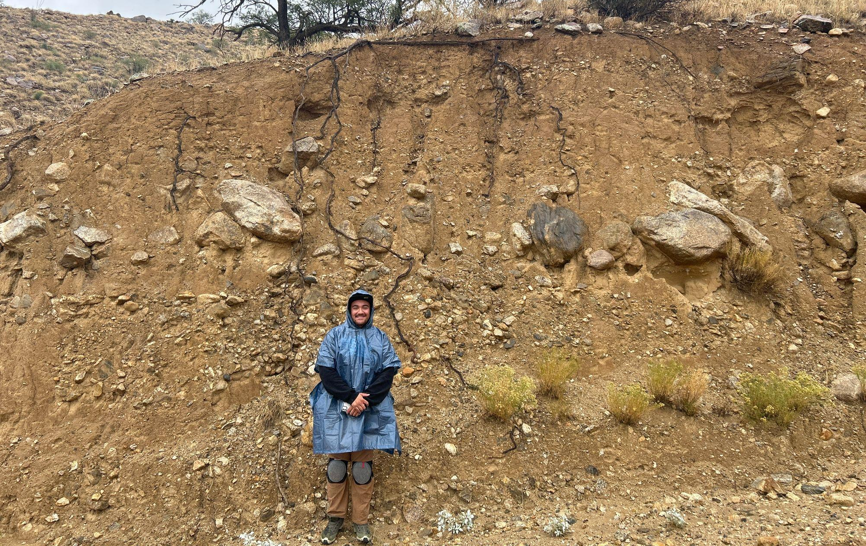
Mapping Details
Transition zone observed from Frye Mesa through the N end of the range front
Identifiable topographic pattern for fine-grained basin fill and transition zone
  Traceable around the rangefront
Highest gravel cap is dissected but correlates to highest fan remnants
At least 4 levels of surfaces lower than the highest gravel cap
  There is still intact basin fill deposits below these lower surfaces

Slide 26
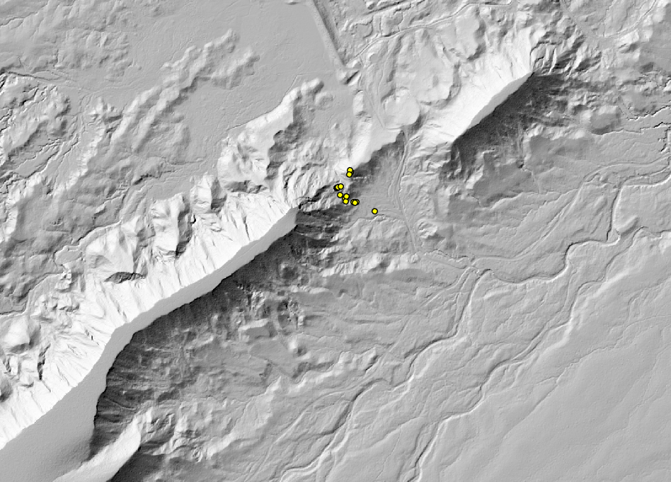
Mapping Details
Transition zone observed from Frye Mesa through the N end of the range front
Identifiable topographic pattern for fine-grained basin fill and transition zone
  Traceable around the rangefront
Highest gravel cap is dissected but correlates to highest fan remnants
At least 4 levels of surfaces lower than the highest gravel cap
  There is still intact basin fill deposits below these lower surfaces

Slide 27
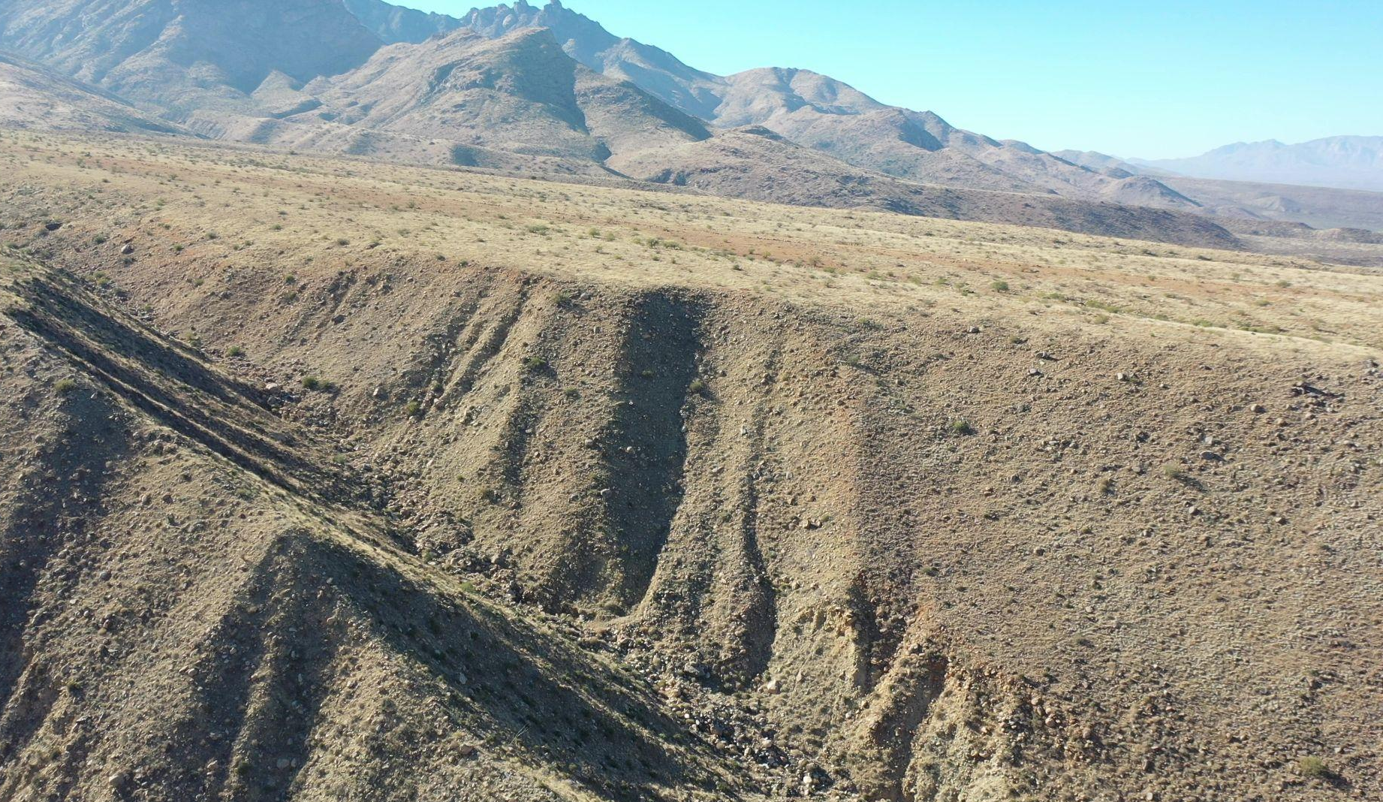
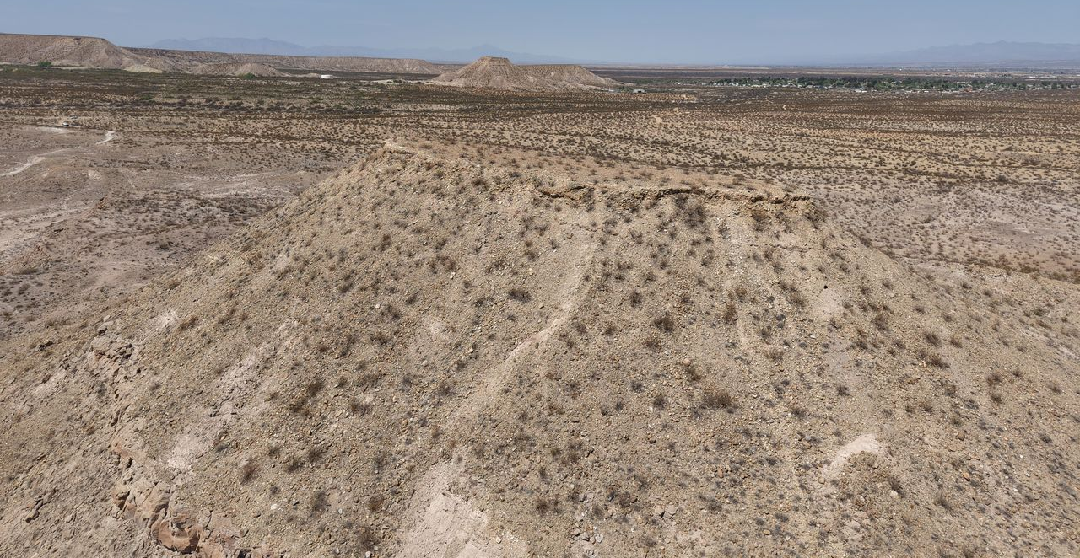
Mapping Details
Transition zone observed from Frye Mesa through the N end of the range front
Identifiable topographic pattern for fine-grained basin fill and transition zone
  Traceable around the rangefront
Highest gravel cap is dissected but correlates to highest fan remnants
At least 4 levels of surfaces lower than the highest gravel cap
  There is still intact basin fill deposits below these lower surfaces

Slide 28
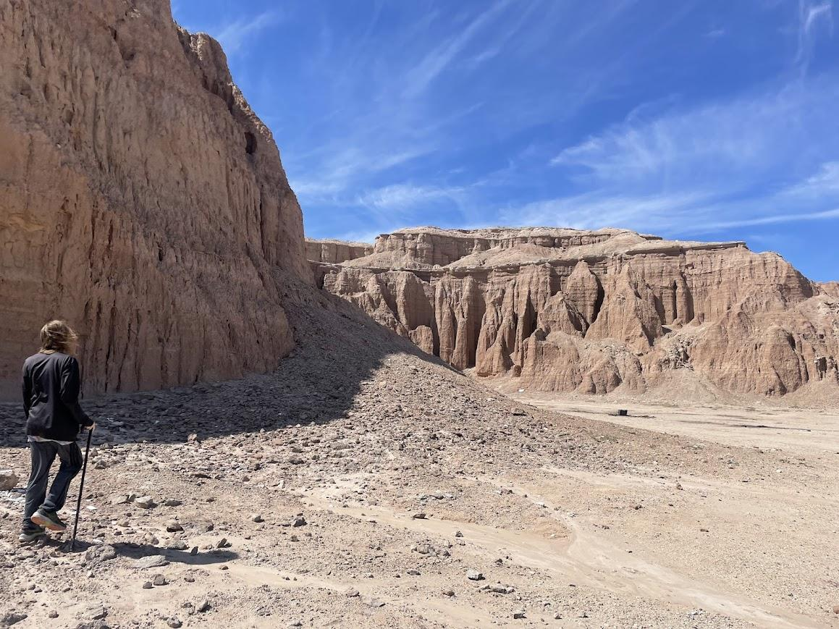
Discussion

Slide 29
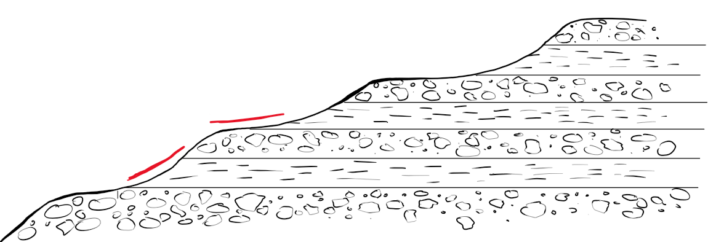
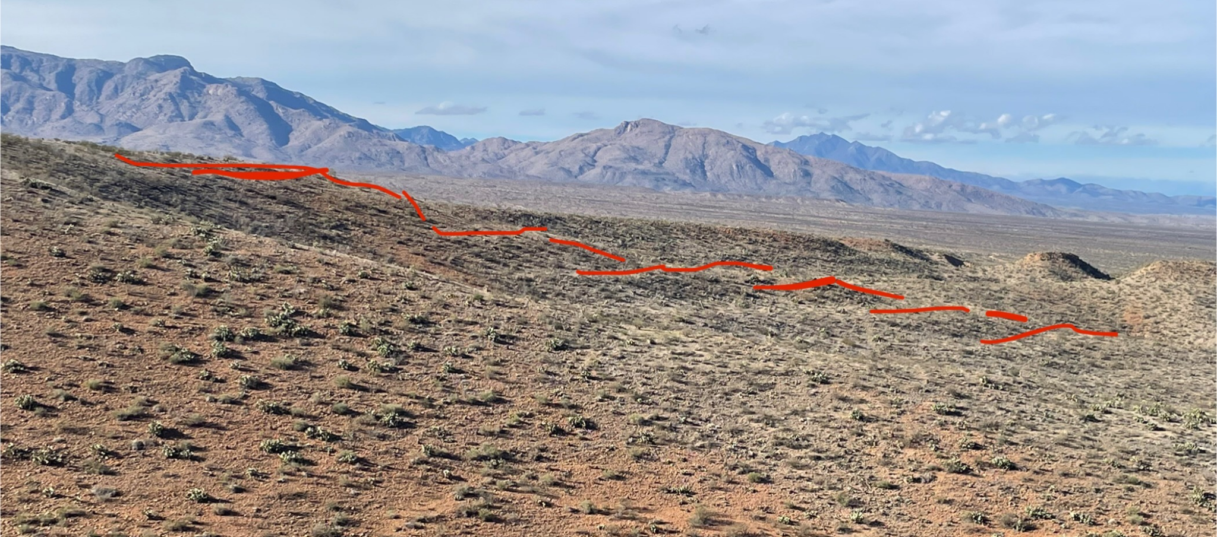
Topographic Patterns of Stratigraphy
The “ledges” are a result of differential erosion between interfingering fine and coarse layers
  This expression in the landscape traces the transition zone
Fine-grained deposits are marked by lumpy remnant terraces surrounding mesas
  A possible way to differentiate underlying deposits
Coarse gravels typically have a smooth appearance

Slide 30
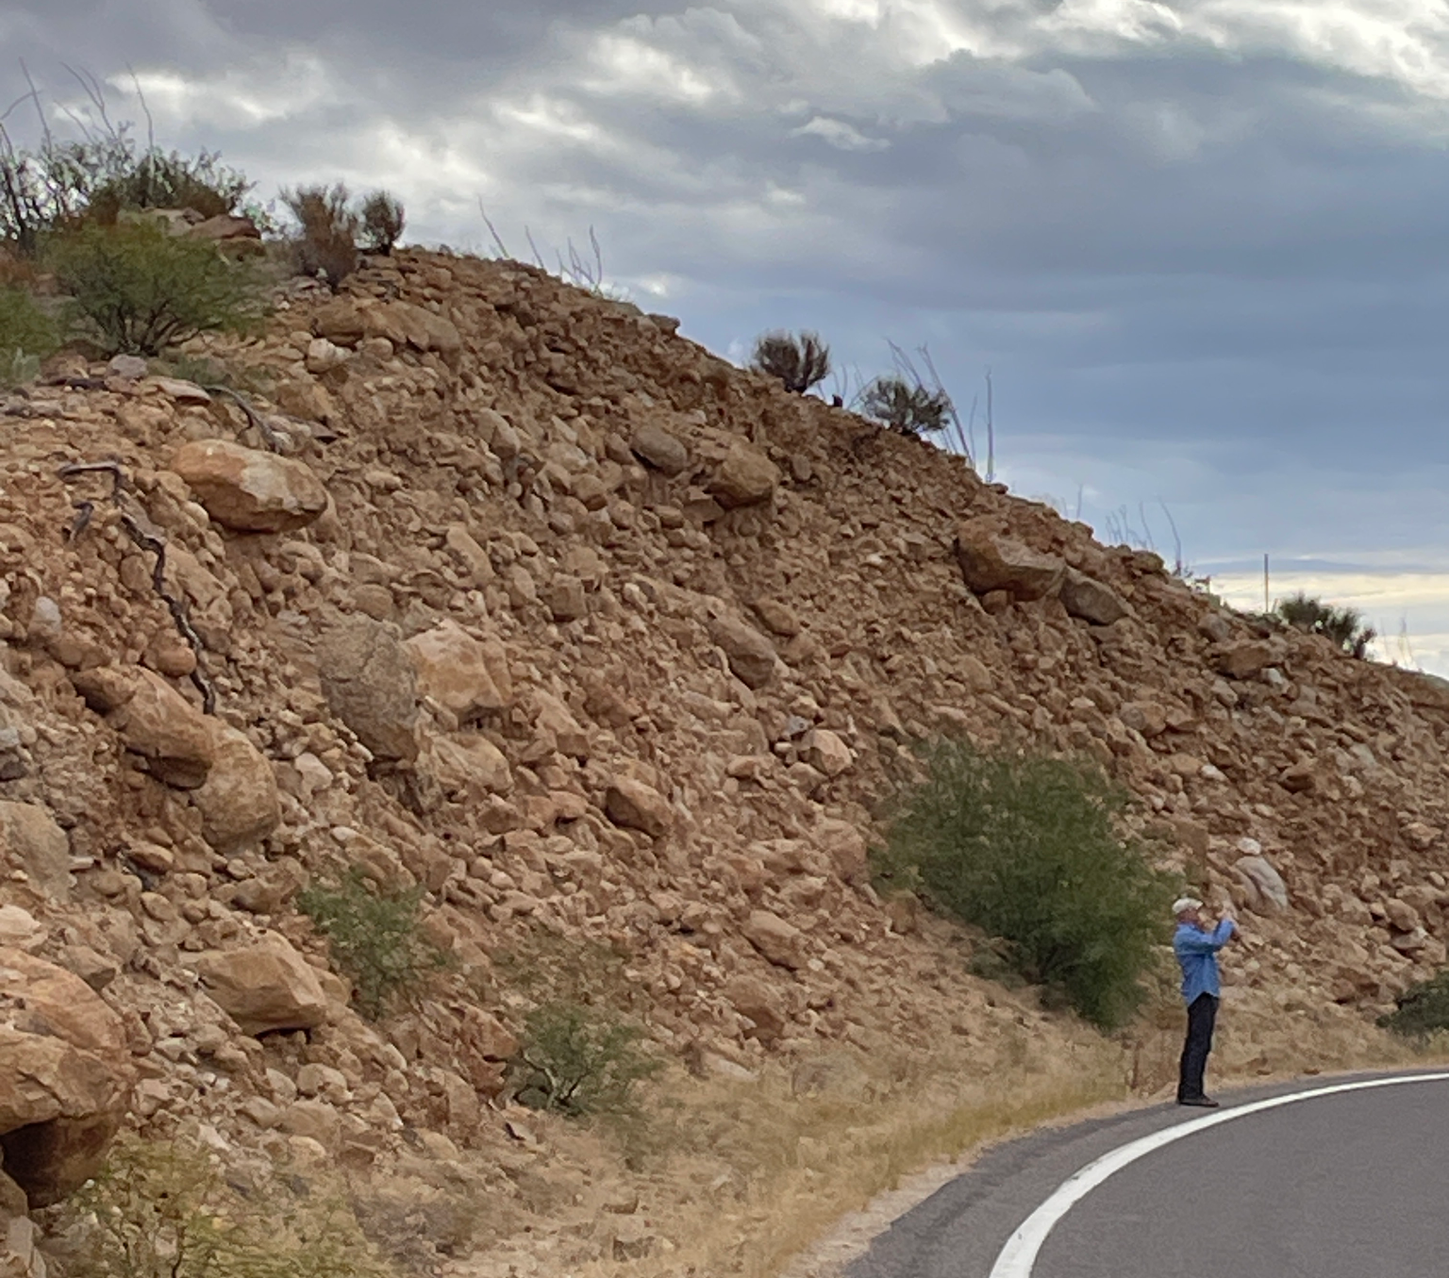
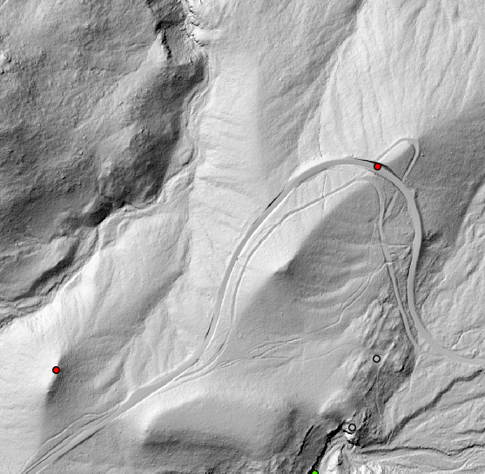
Topographic Patterns of Stratigraphy
The “ledges” are a result of differential erosion between interfingering fine and coarse layers
  This expression in the landscape traces the transition zone
Fine-grained deposits are marked by lumpy remnant terraces surrounding mesas
  A possible way to differentiate underlying deposits
Coarse gravels typically have a smooth appearance

Slide 31
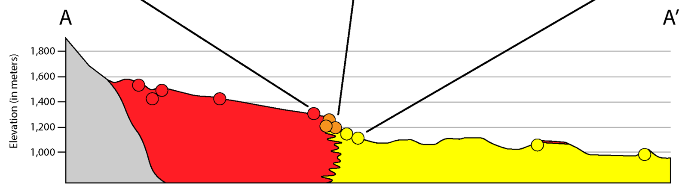
Implications of the Transition Zone
The broad zone of interfingering gravels and fine-grained deposits necessitates that they are laterally adjacent and coeval
  Supports hypothesis 2!
These facies shifts likely reflect changes in sediment input and lake level
  Due to small variations in climate
Since the highest gravel cap is correlative with the alluvial fan deposits, the cap represents a sudden progradation at the end of deposition
Alluvial Fan
Transition Zone
Fine Basin Fill

Slide 32
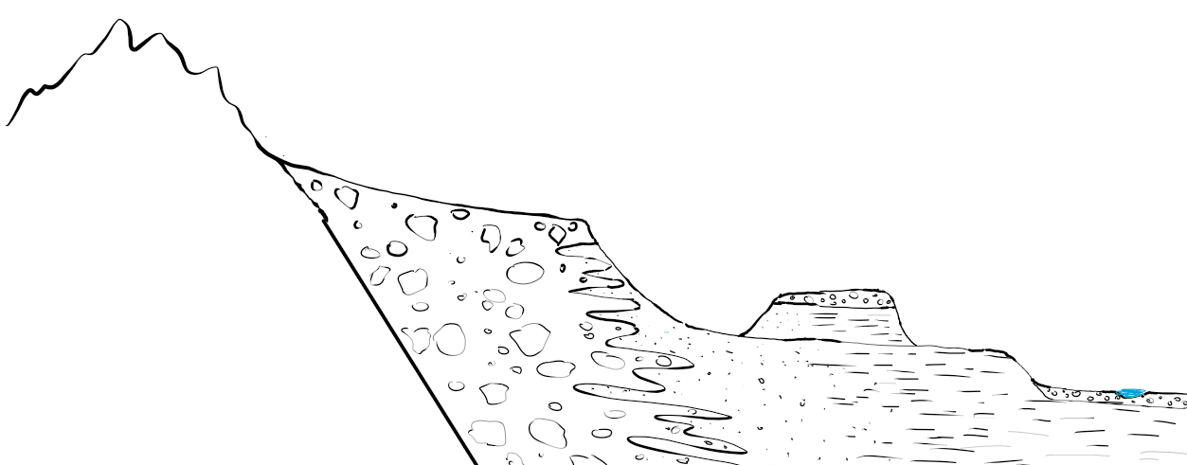
Significance of Lower Gravel Caps
We know that deposition ended ca. 2.0 Ma from burial dating using cosmogenic nuclides (Jungers and Heimsath, 2016)
Since, there has been significant incision(>150 m), with periods of aggradation (we know from inset fill)
The lower surfaces most likely represent remnant terraces where the tributary streams meandered and aggraded
This left a series of gravel caps or terraces, each lying disconformably on the basin fill below
Highest basin floor level
Exposed sediments
Remnant terrace
Modern Gila River

Slide 33
Acknowledgements
This research was made possbile by funding from ASU/NASA Space Grant and NSF EAR-2229222 to Kelin Whipple
Thank you to Kelin Whipple for mentorship and guidance throughout this project.
Thank you to Emily Godin for assistance and support, as well as Emily Speckman, Cambria Leben, and the members of our research group for support in and out of the field.
Thank you!

